Slide 1
List 12

Slide 2
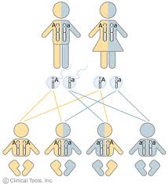
law of segregation
- law that states that gene
pairs separate during the sex cell formation

Slide 3
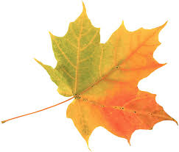
leaf
- plant structure where photosynthesis occurs

Slide 4
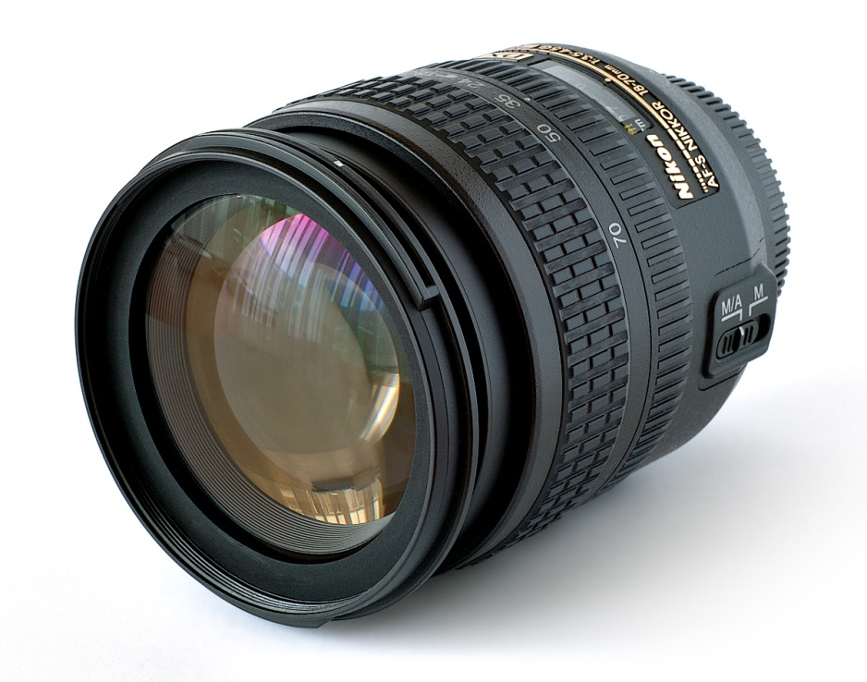
lens
- curved piece of glass or fluid filled sac of
the eye that bens light rays as they pass
through

Slide 5
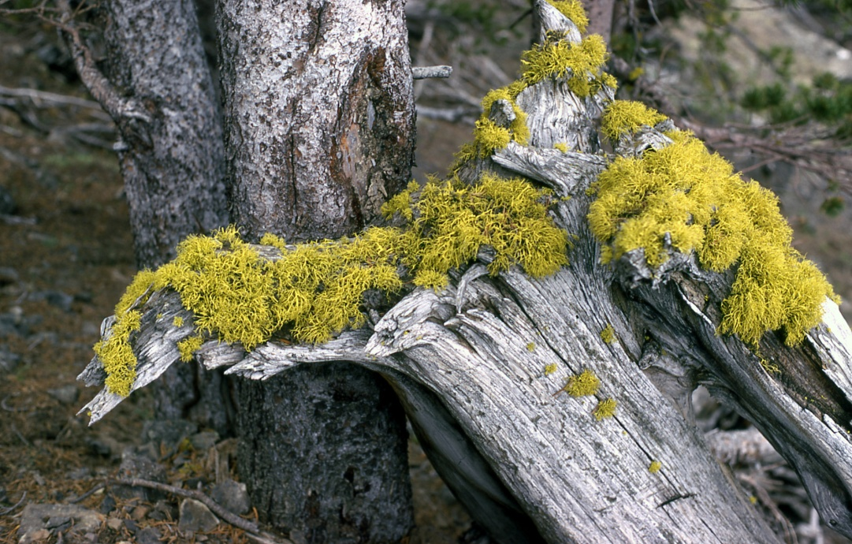
lichen
- organism made of a fungus and algae
living together in a symbiotic relationship
(both benefit)

Slide 6
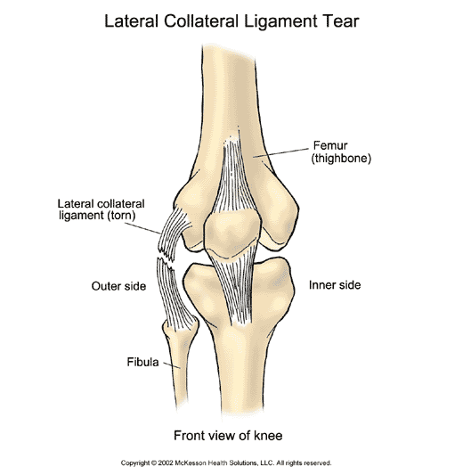
ligament
- stringy, connective tissue that holds
bones together

Slide 7
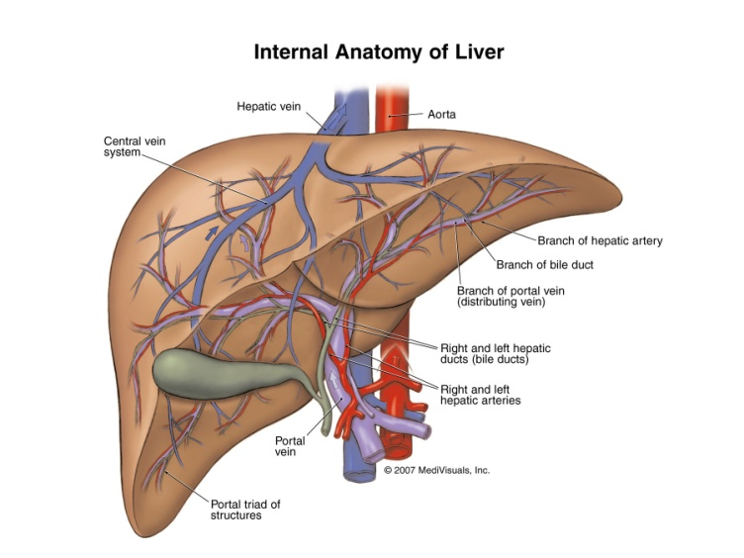
liver
- organ that produces bile and breaks
down amino acids

Slide 8
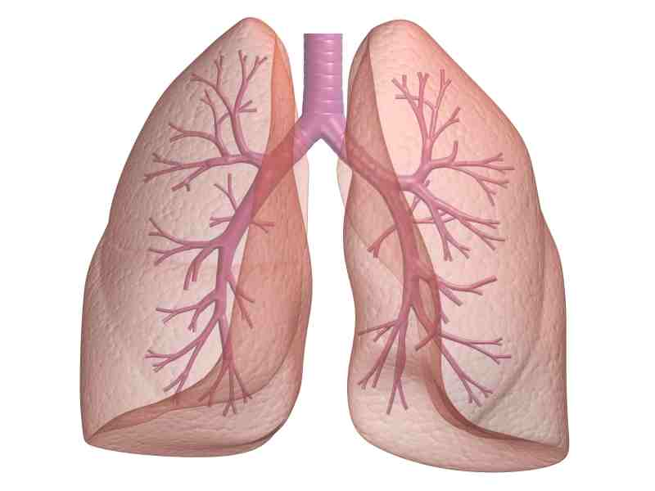
lungs
- pair of respiratory organs in which gases
are exchanged between the blood and the
environment

Slide 9
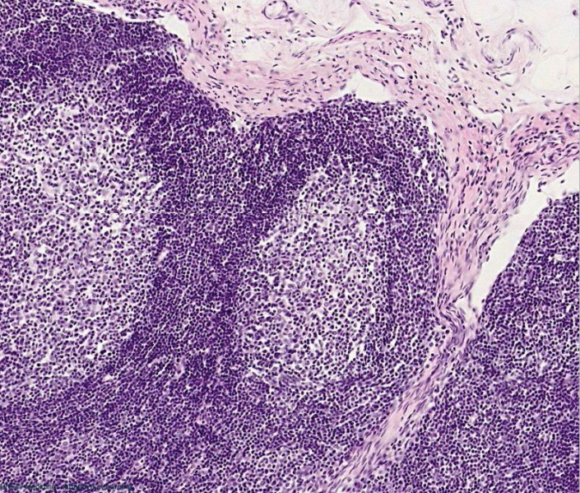
lymph
- fluid that bathes all body cells

Slide 10
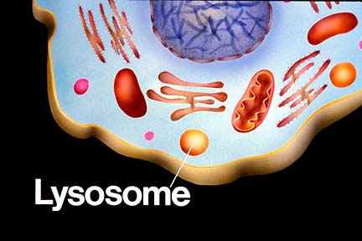
lysosome
- cell organelle involved in digestion

Slide 11
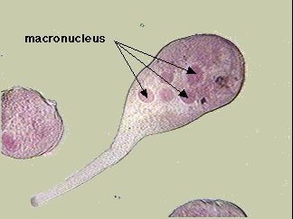
macronucleus
- large nucleus in a paramecium
that controls life functions

Slide 12
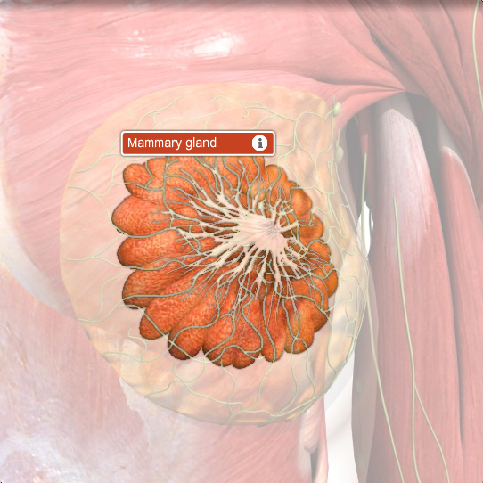
mammary glands
-female breasts that produce
milk to nourish newborn offspring

Slide 13
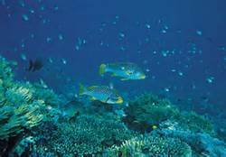
marine biome
- ocean biome (salt water)

Slide 14
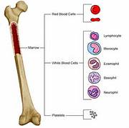
marrow
- soft material inside bone

Slide 15
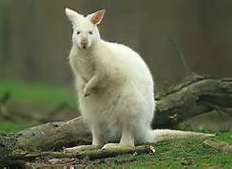
marsupial
- pouched animal

Slide 16
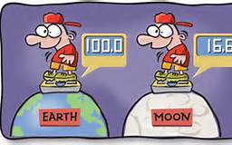
mass
- measure of the amount of matter in an
object

Slide 17
Good Luck!

