Slide 1
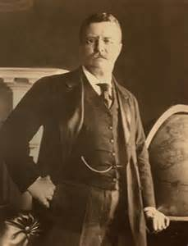
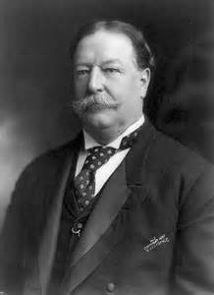
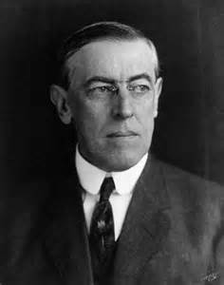
Progressive Presidents:
Changing the Role of the Presidency

Slide 2
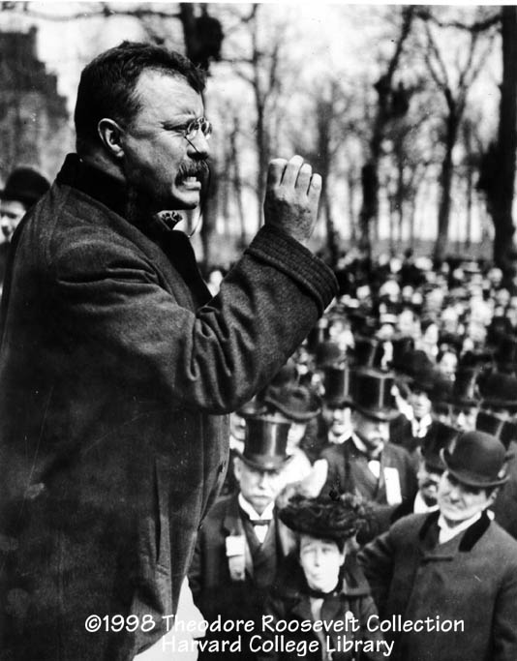
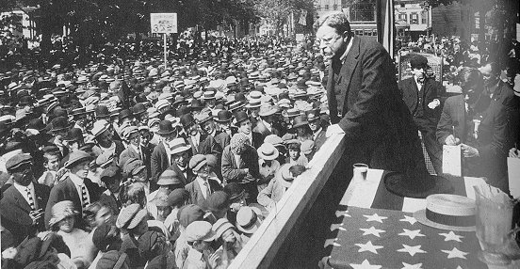
I. Theodore Roosevelt
Bully Pulpit
Use of the presidency to influence the media and other politicians

Slide 3
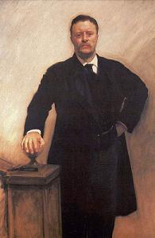
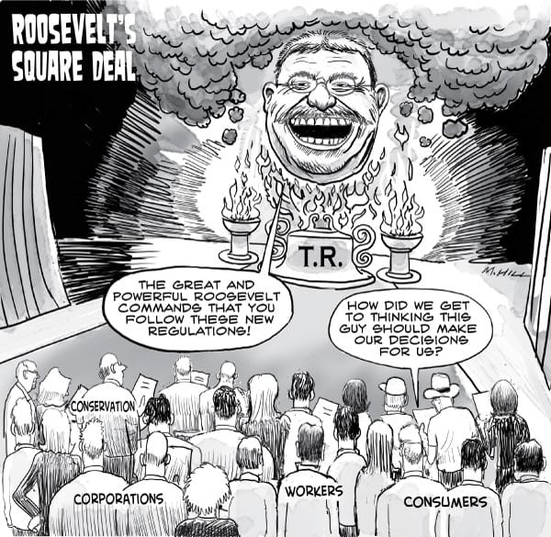
b. Square Deal
Domestic program called for:

Slide 4
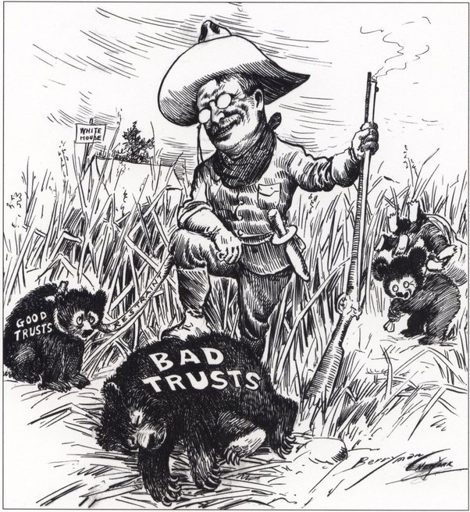
1. Breaking up “bad” trusts

Slide 5
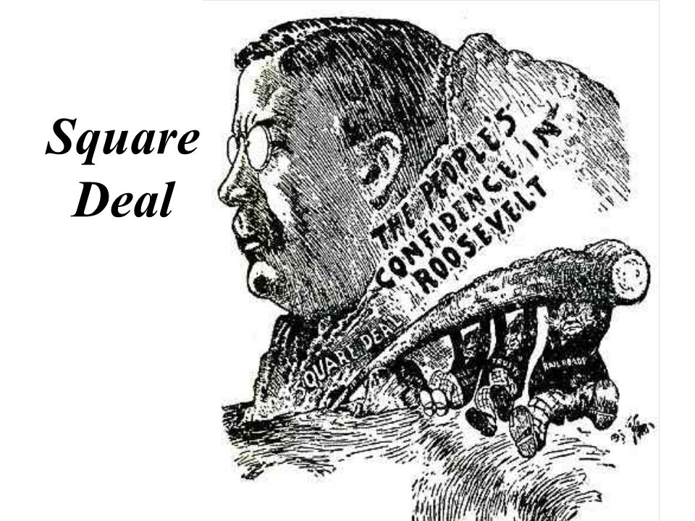
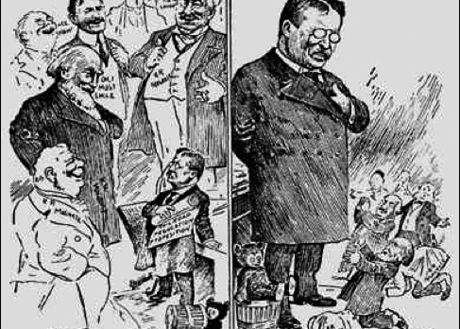
2. Fairness for all citizens

Slide 6
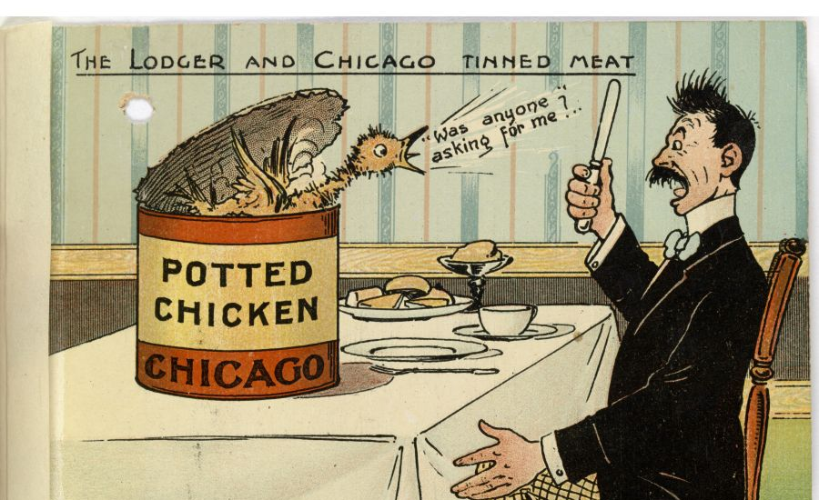
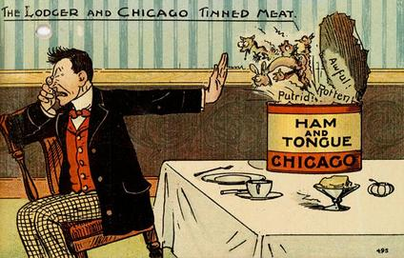
3 Consumer Protection

Slide 7
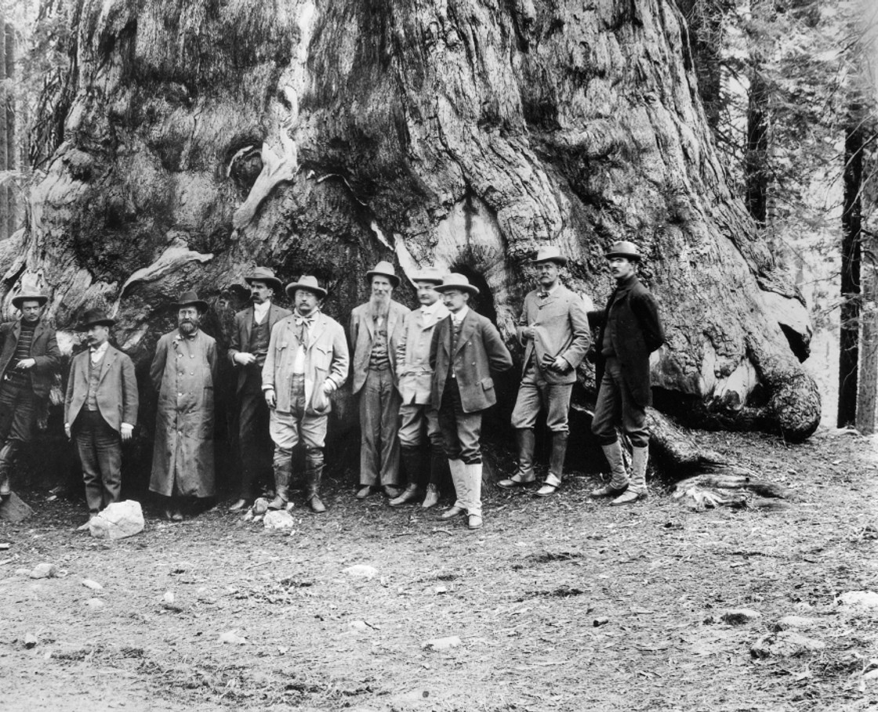
4. Conservation

Slide 8
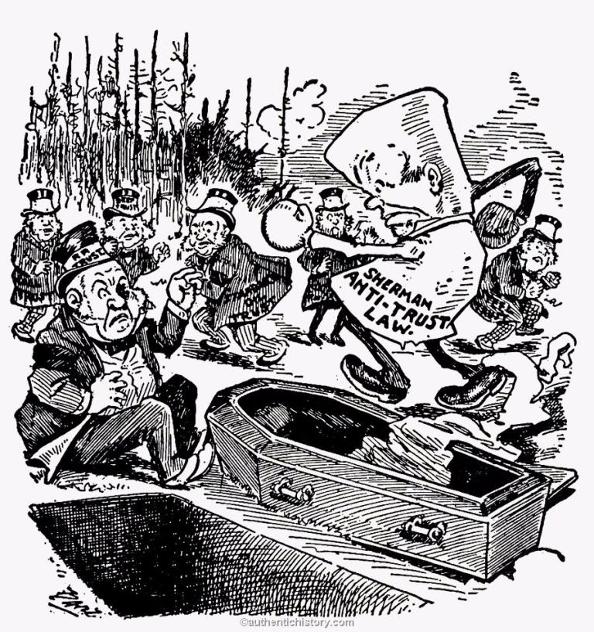
ii. Trust busting (really trust regulating)
Began to use the Sherman Antitrust Act

Slide 9
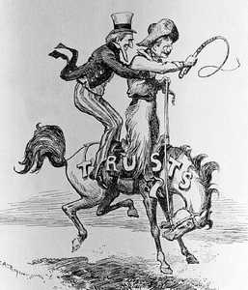
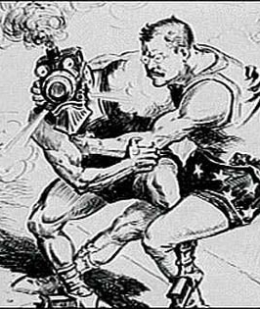
a. Northern Securities Co. v. US (1904)
Roosevelt enforced Sherman Antitrust Act
Major victory for antitrust movement

Slide 10
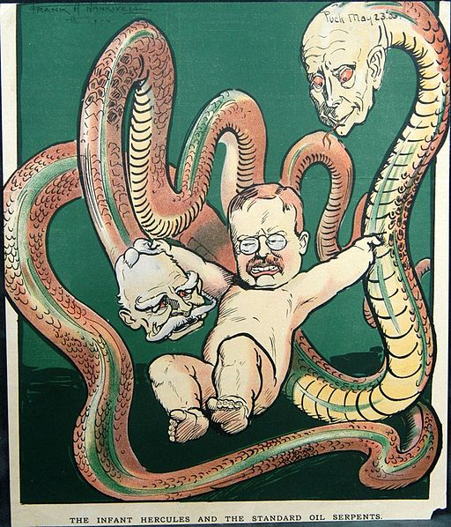
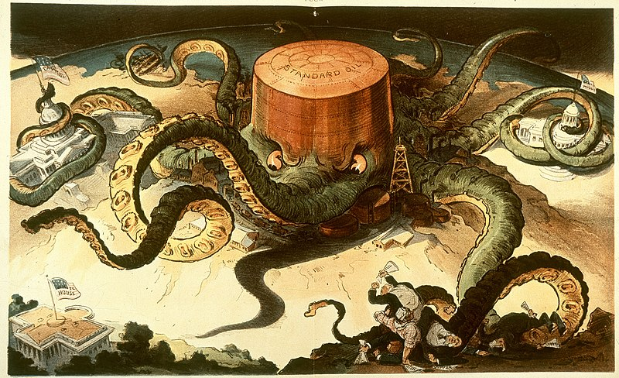
b. Standard Oil

Slide 11
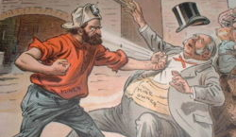
iii. Fairness for all citizens
Anthracite Coal Strike (1902)
Coal miners went on strike
TR sent both sides to arbitration

Slide 12
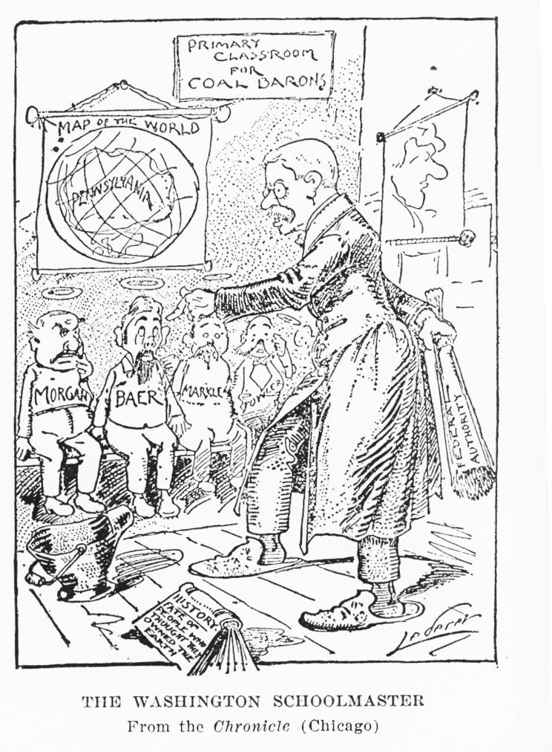
i. Workers got more money and fewer hours
c. set new precedent
If a strike threatened the public, the government must intervene

Slide 13
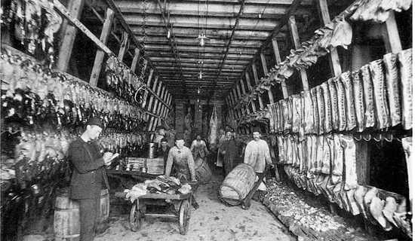
iv. Consumer Protection
Regulating Food
Decided to act b/c of The Jungle

Slide 14
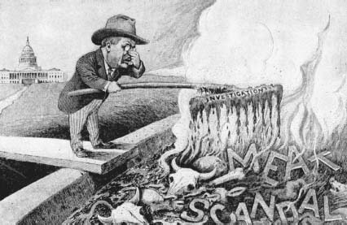
i. Meat Inspection Act
Demanded inspection and sanitary meatpacking conditions

Slide 15
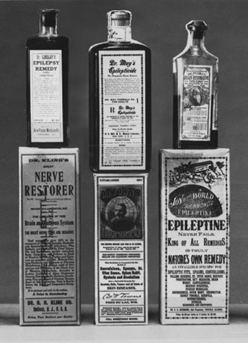
ii. Pure Food and Drug Act
Ended the sale of contaminated products
Food recalls
Demanded truthful labels
Current US recalls

Slide 16
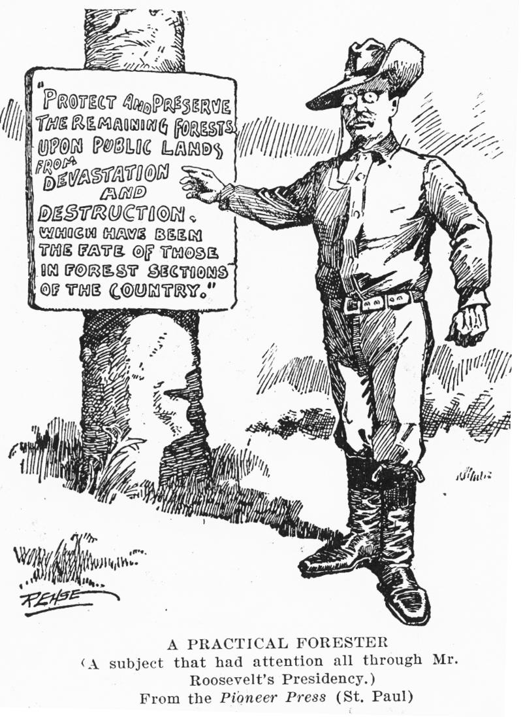
v. Conservation of natural resources

Slide 17
1. Created five national parks

Slide 18
2. 1906 Antiquities Act

Slide 19
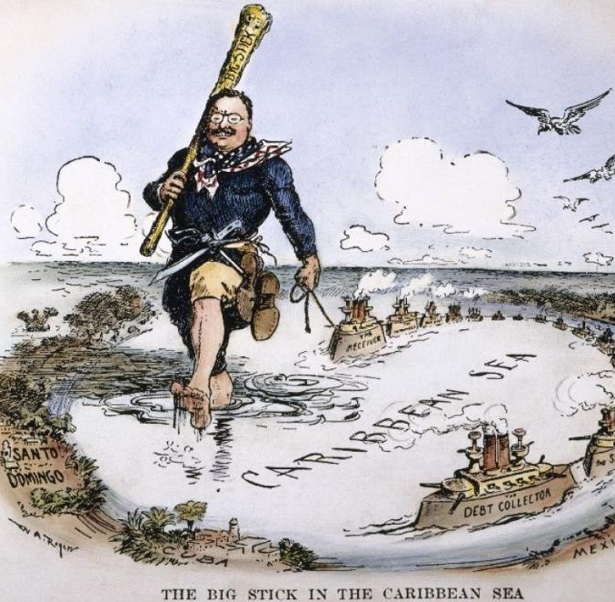
c. Foreign Policy
i. “Speak softly and carry a big stick!”

Slide 20
1. Great White Fleet

Slide 21
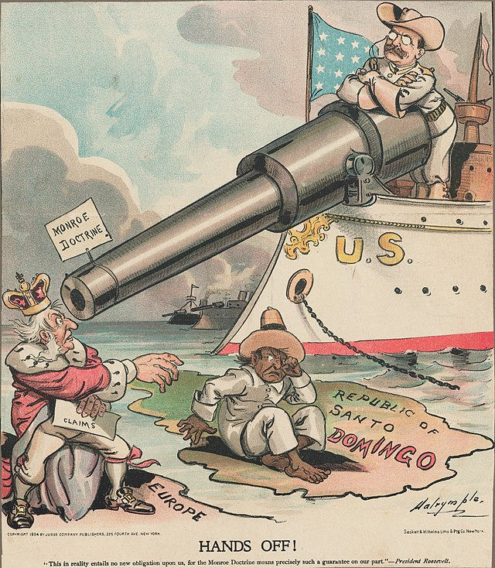
2. Roosevelt Corollary

Slide 22
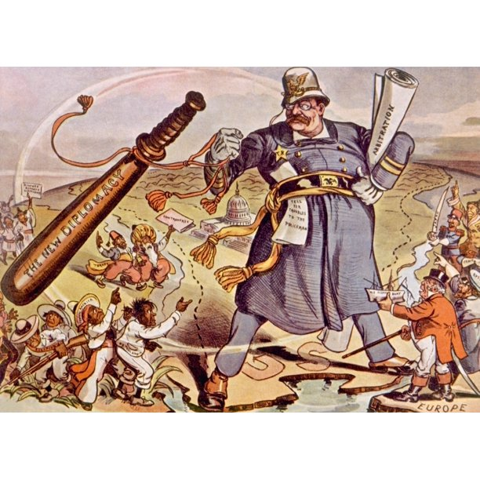
a. US would be the policeman of the Western Hemisphere

Slide 23
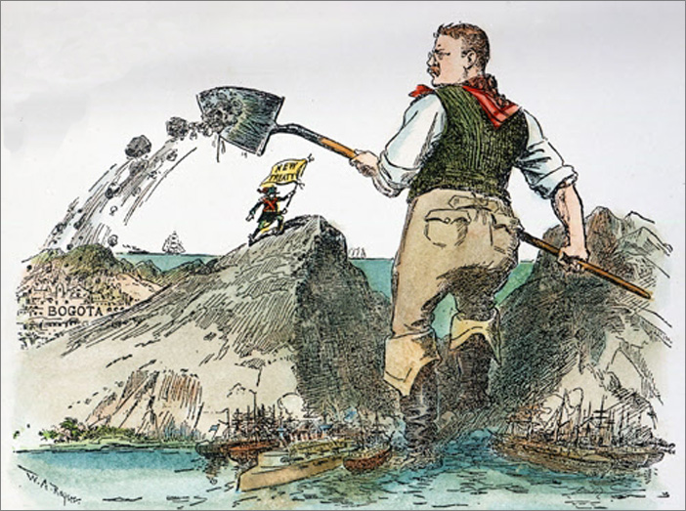
ii. Panama Canal

Slide 24
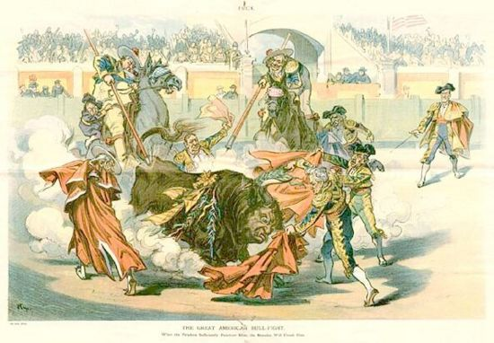
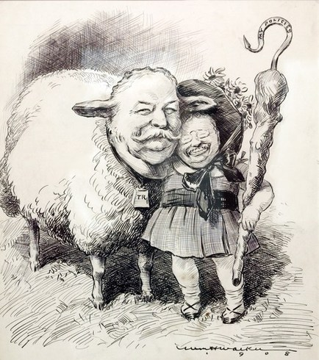
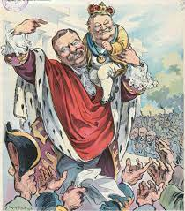
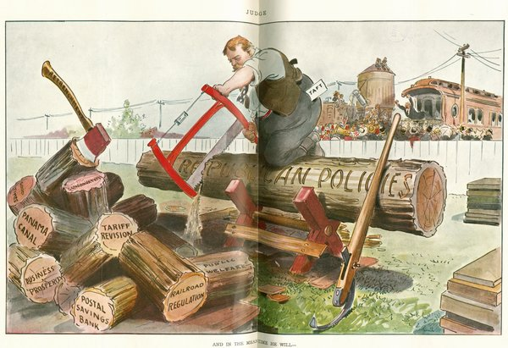
II. William Howard Taft
Real Trustbuster

Slide 25
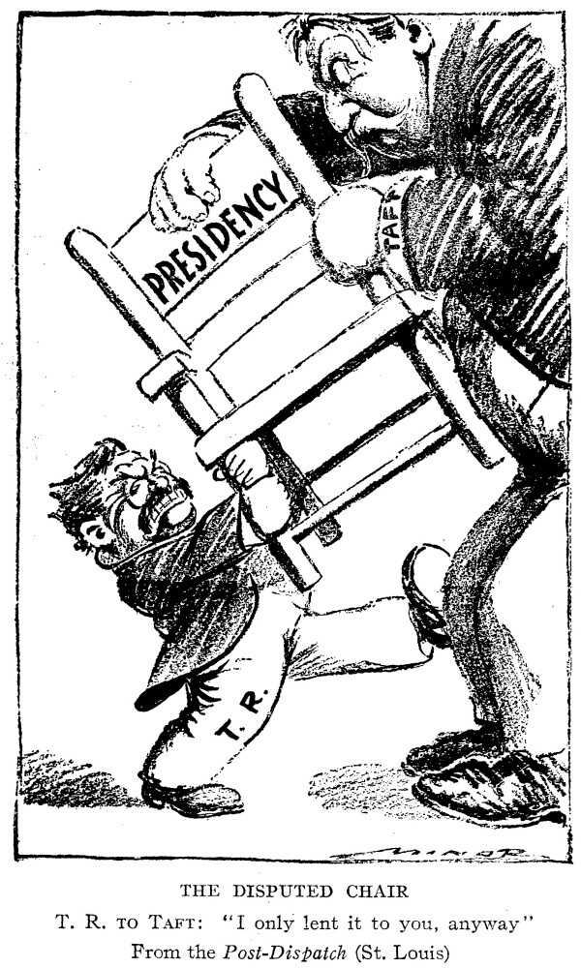
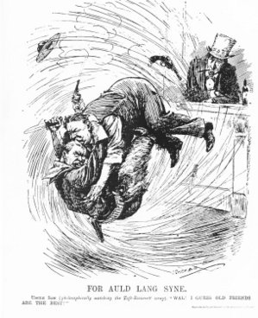
b. Feud with TR
i. Disagreement over progressive policies

Slide 26
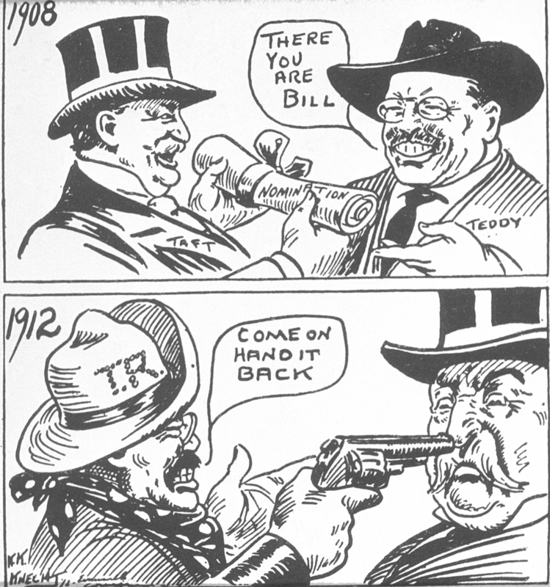
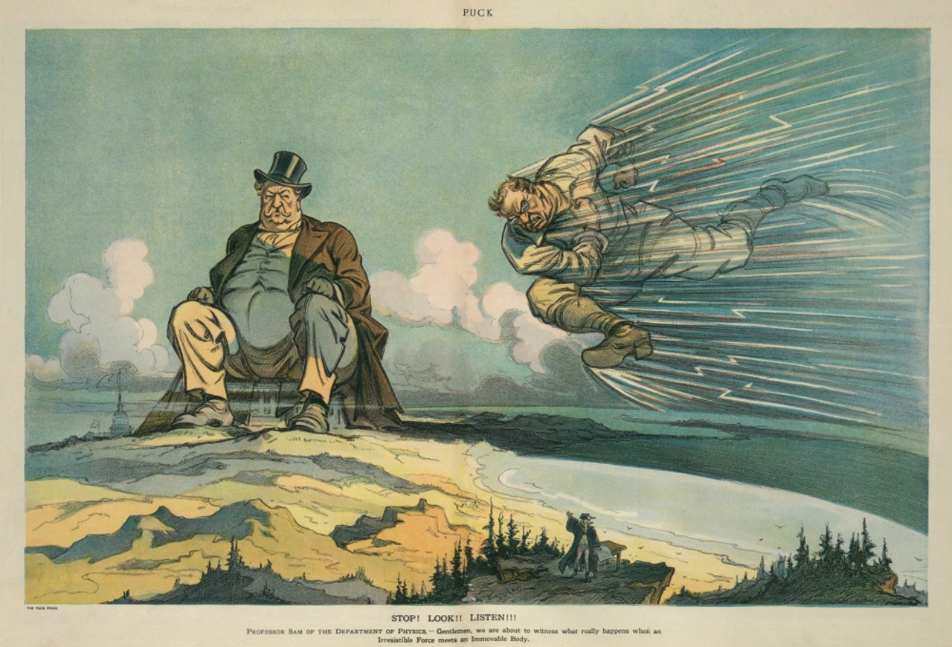
1. Roosevelt decided to run for a 3rd term

Slide 27
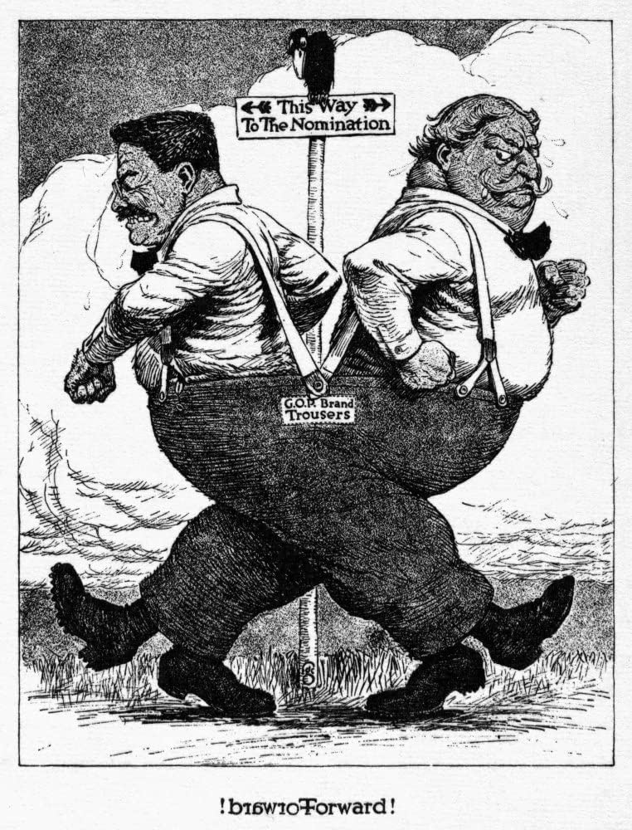
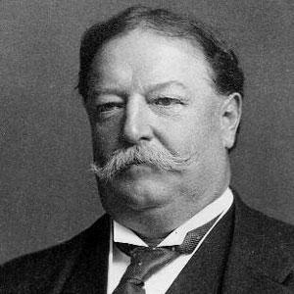
III. Election of 1912
Republican Party Split
Republicans (Conservative)
William Howard Taft

Slide 28
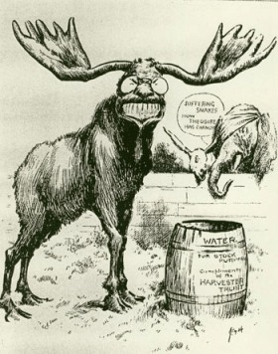
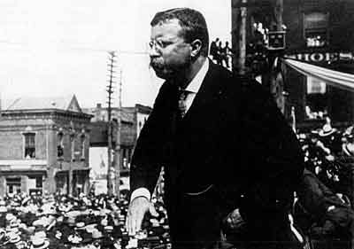
ii. Bull Moose Party (Progressive)
1. Theodore Roosevelt

Slide 29
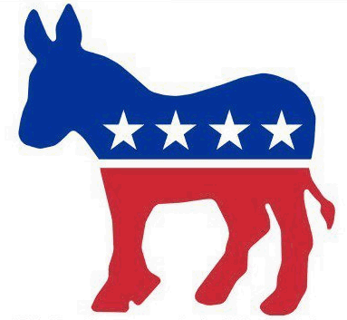
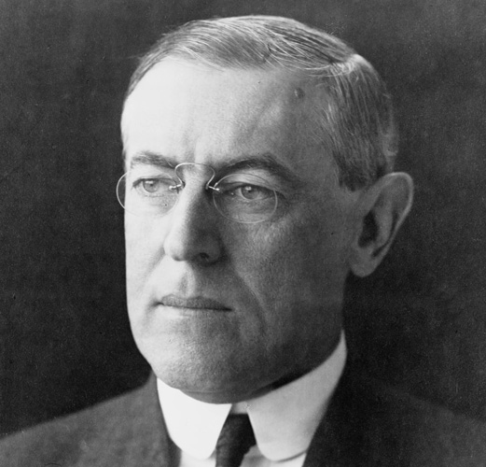
iii. Democrats
Woodrow Wilson

Slide 30
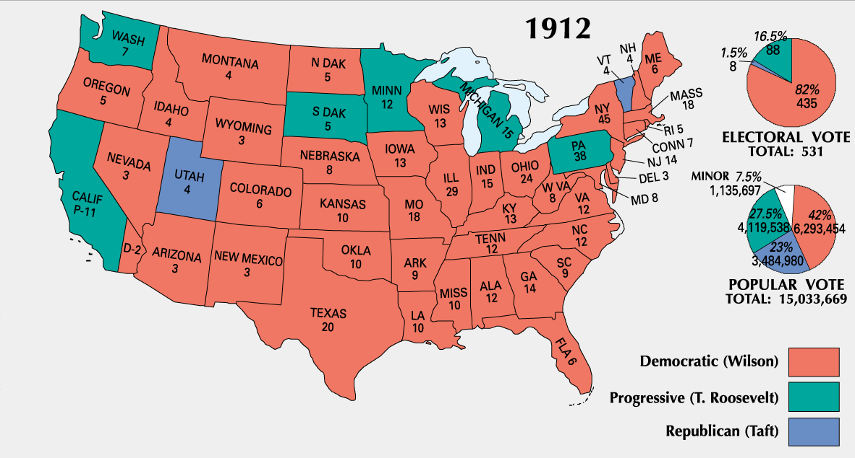
b. Split in the Republican Party secured the election for Wilson

Slide 31
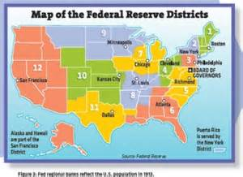
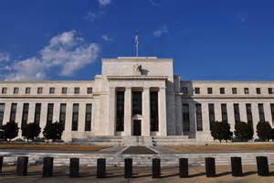
IV. Woodrow Wilson
Created
Federal Reserve System
Regulates monetary supply

Slide 32
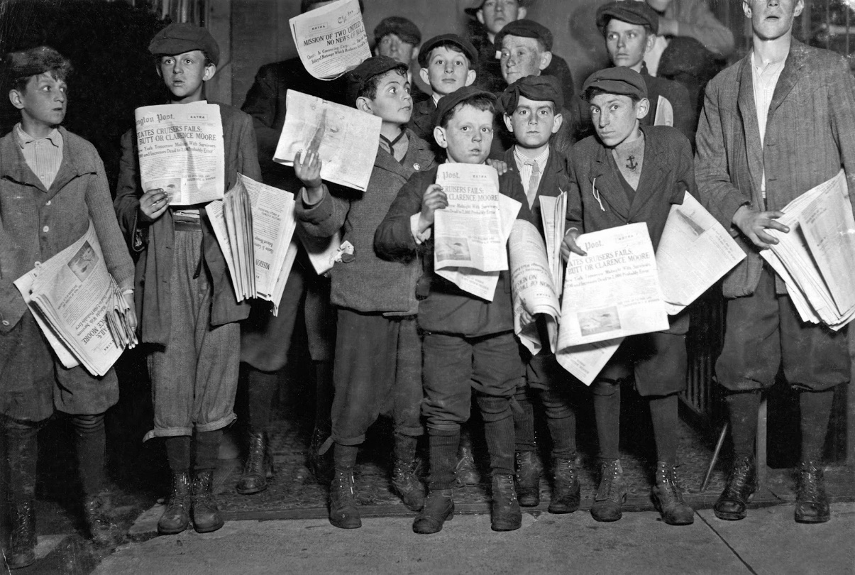
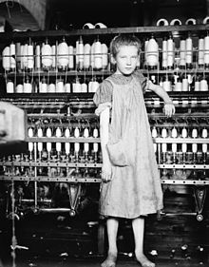
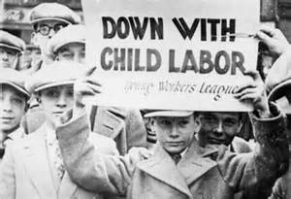
b. Keating-Owen Act
Limited child labor

Slide 33
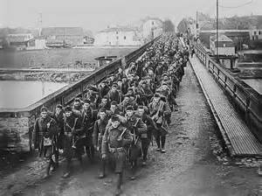
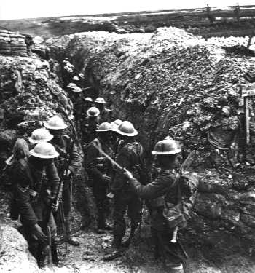
c. Outbreak of War
WWI ended the Progressive Era
International war distracted the public and lawmakers

Slide 34
V. Legacy of the Progressive Era
a. Oppressed could organize and have political impact

Slide 35
b. Agenda of reform would be carried into the 20th century

Slide 36
c. Government was now expected to make the country better
Regulating the economy
Solve social problems

