Slide 1
List # 17

Slide 2
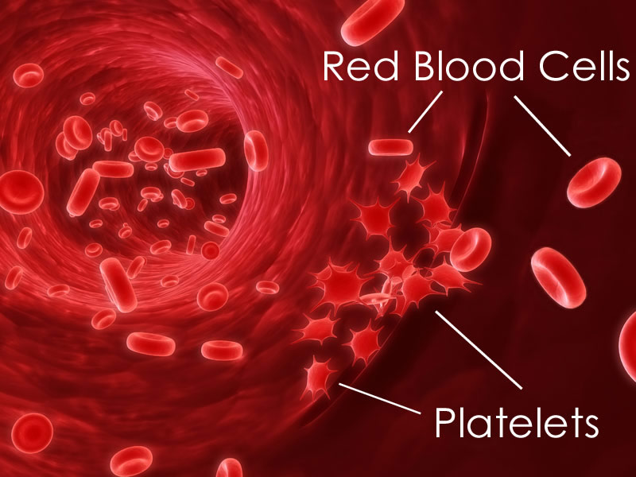
platelet
blood cell fragment the help in blood clotting

Slide 3
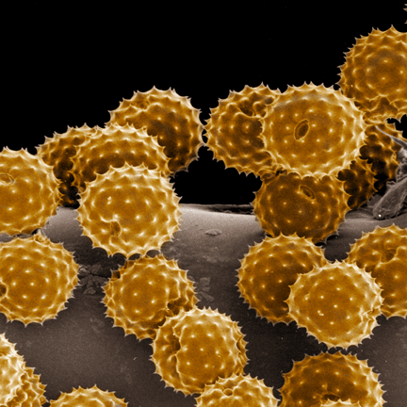
pollen
contains the male sex cells of a seed plant

Slide 4
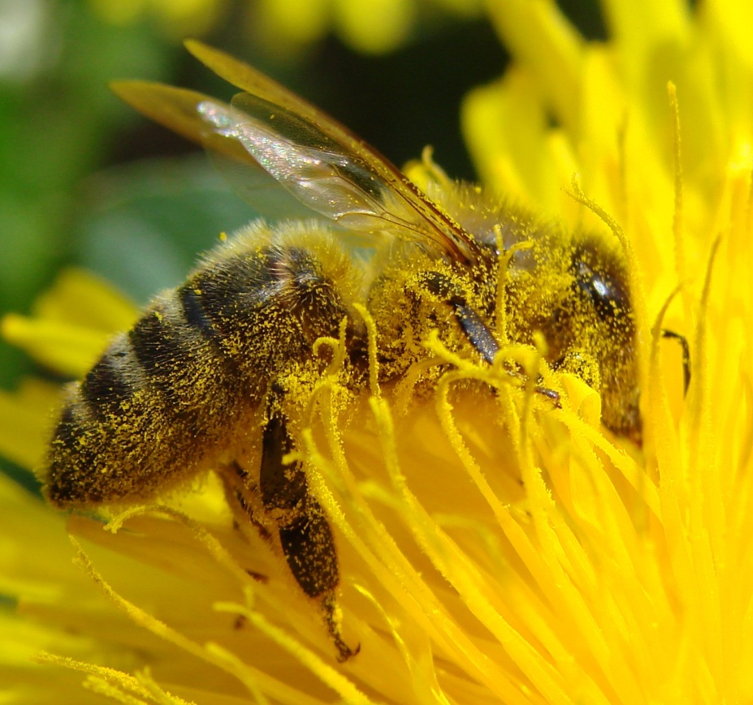
pollination
transfer of pollen the male part to the female part of the flower

Slide 5
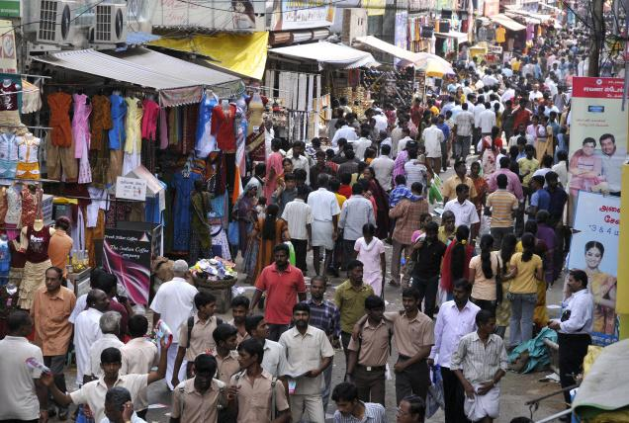
population
group of the same type of organisms living together in the same area

Slide 6
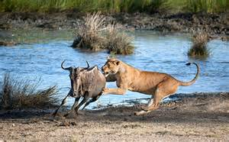
predator
animal that kills and eats other organisms

Slide 7
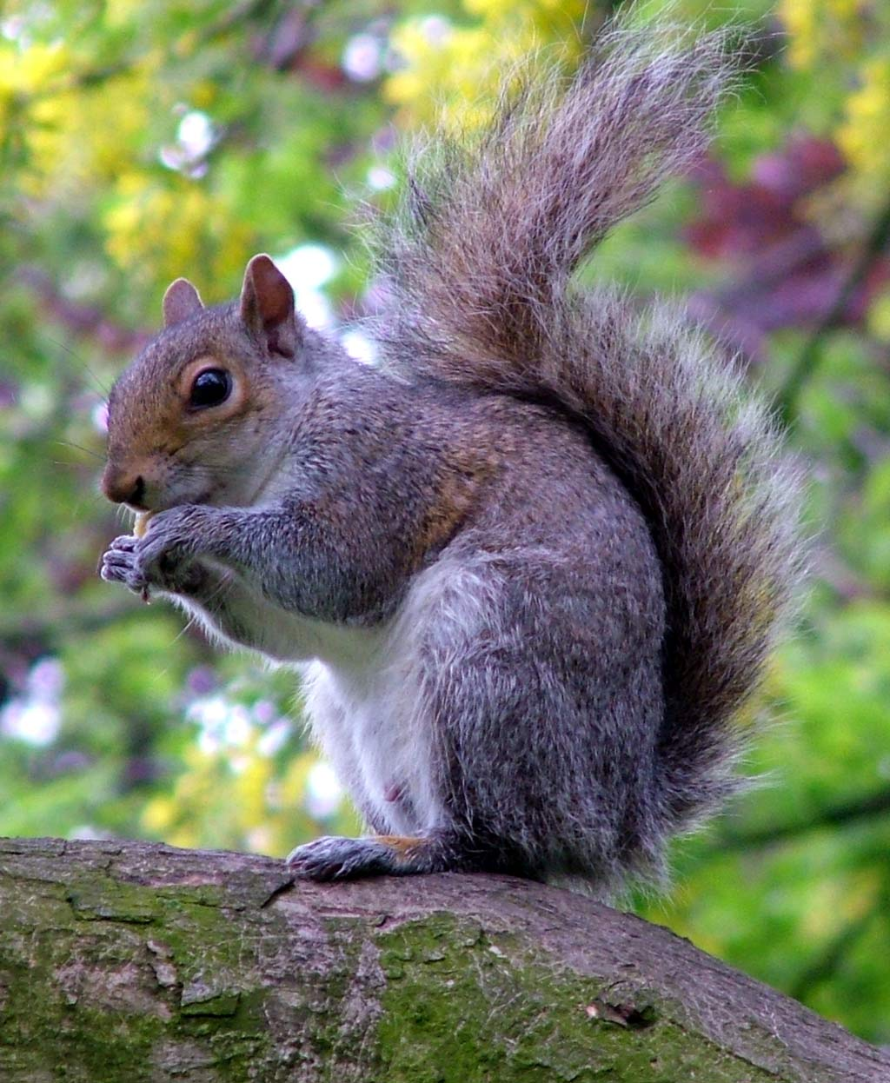
prey
organism that is killed by a predator

Slide 8
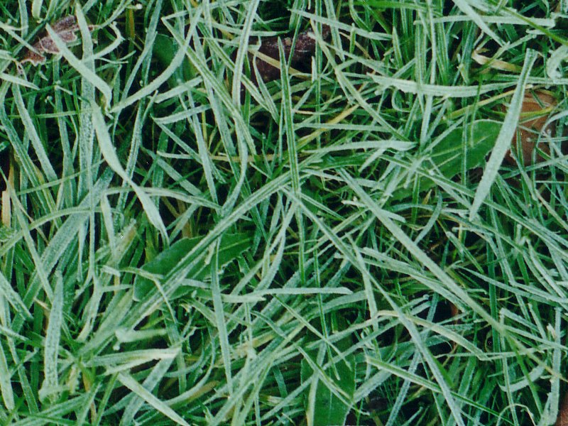
producer
organism that can make its own food

Slide 9
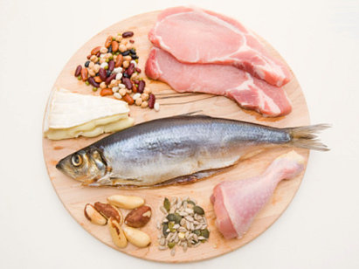
protein
substance, made of amino acids, used to build and repair cells

Slide 10
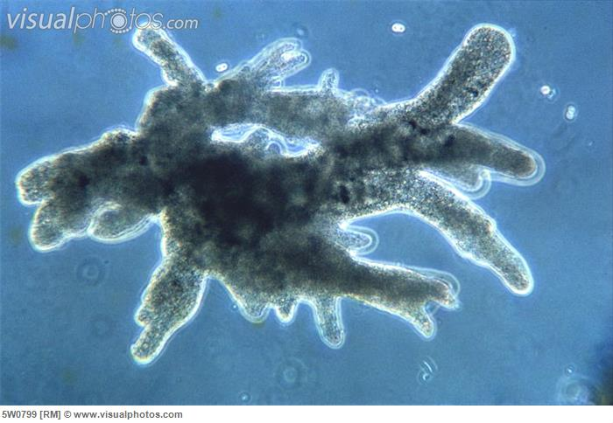
pseudopods
“false feet”, used by a sarcodine to move and get food

Slide 11
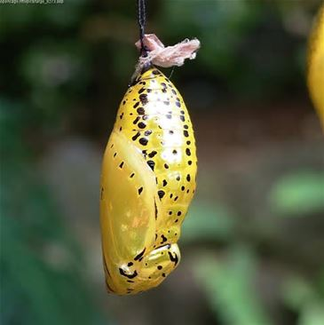
pupa
stage in an insect’s development following the larva stage ex. cocoon

Slide 12
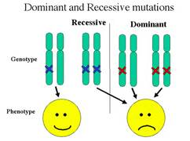
recessive
weaker trait in genetics

Slide 13
red blood cell
cells containing hemoglobin
that carry oxygen throughout the body

Slide 14
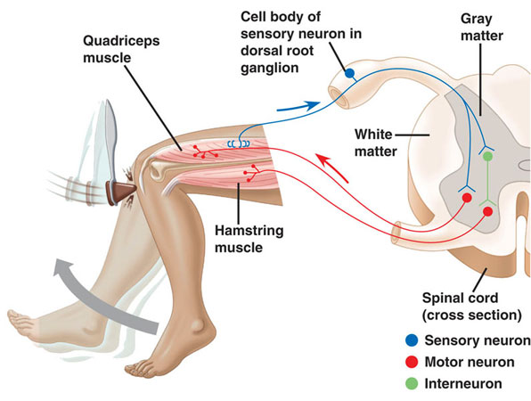
reflex
automatic response to a stimulus

Slide 15
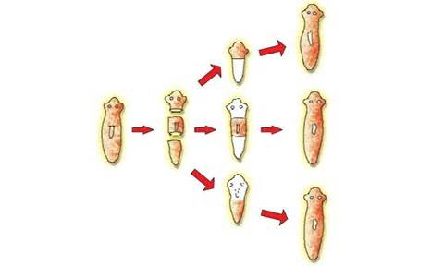
regeneration
ability of an organism to regrow a lost part

Slide 16
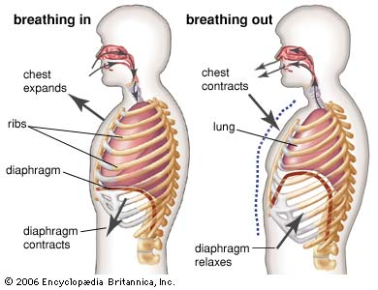
respiration
energy making process of all living things that requires oxygen

Slide 17
GOOD LUCK!

