Slide 1
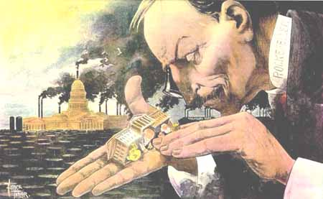
Fewer Control More

Slide 2
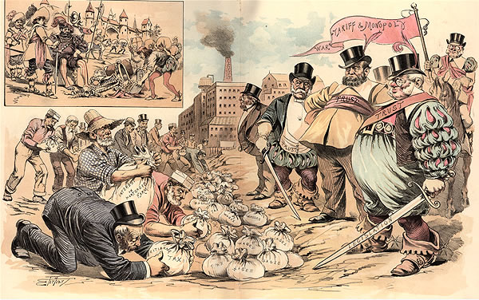
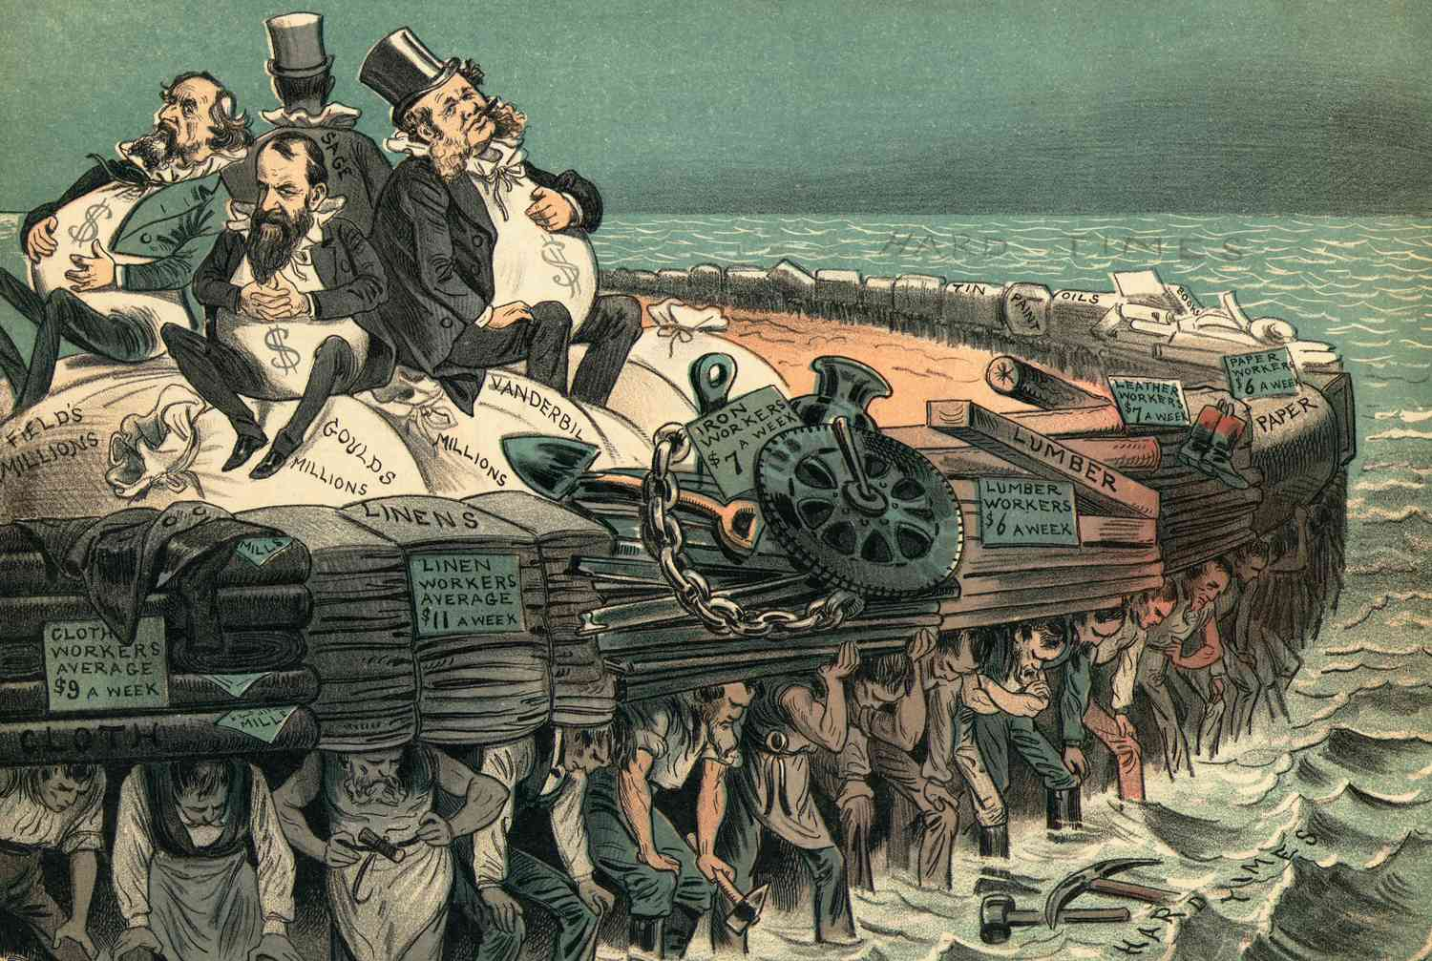
I. Robber Barons or Captains of Industry
Robber Barons
Businessmen
bullied their way to success at the expense of competitors and employees

Slide 3
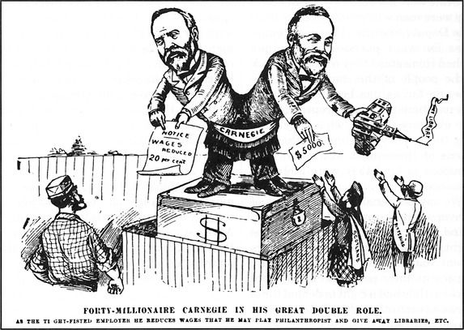
b. Captains of Industry
Businessmen
Created personal fortune while contributing positively to the country in some way

Slide 4
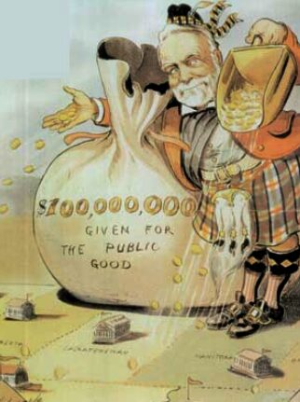
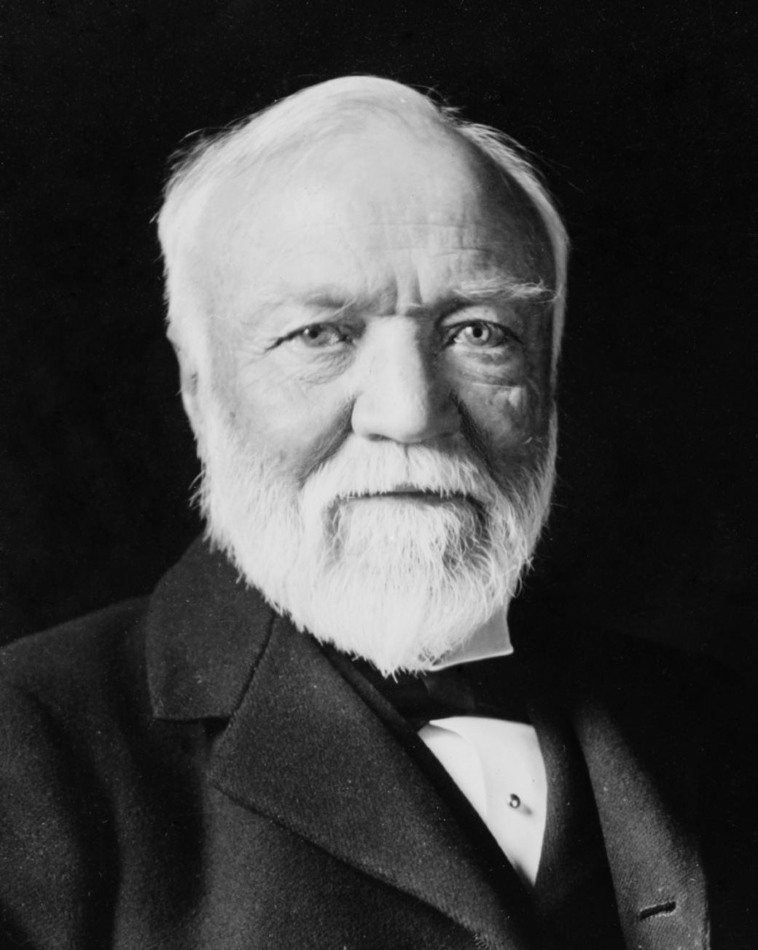
Andrew Carnegie
Philanthropist
Practiced Gospel of Wealth
“He who dies rich, dies disgraced.”
Carnegie Steel
Monopoly on steel production

Slide 5
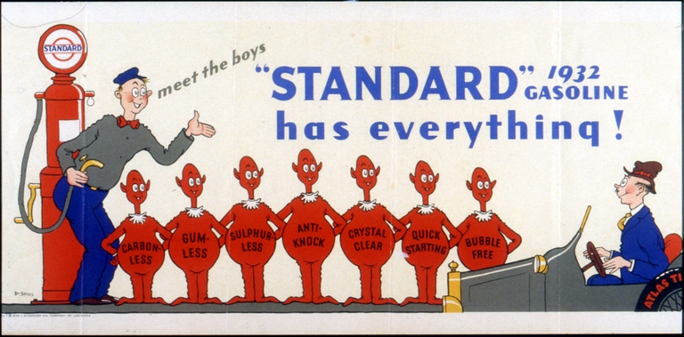
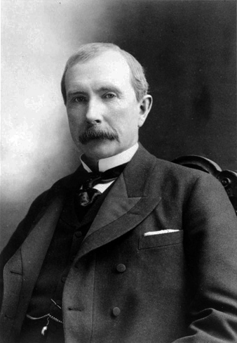
John D. Rockefeller
Standard Oil
Controlled 90% of the oil industry

Slide 6
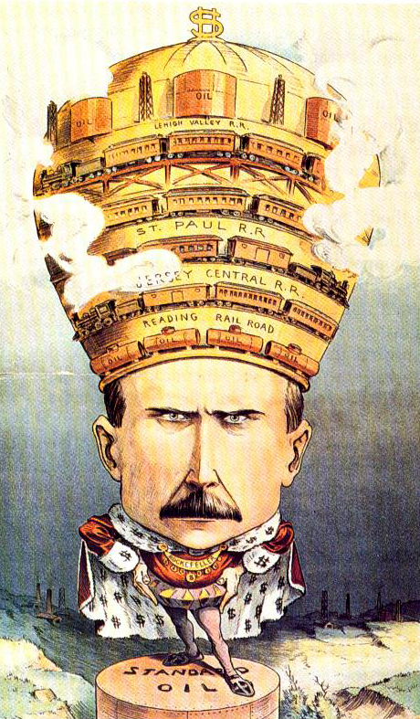
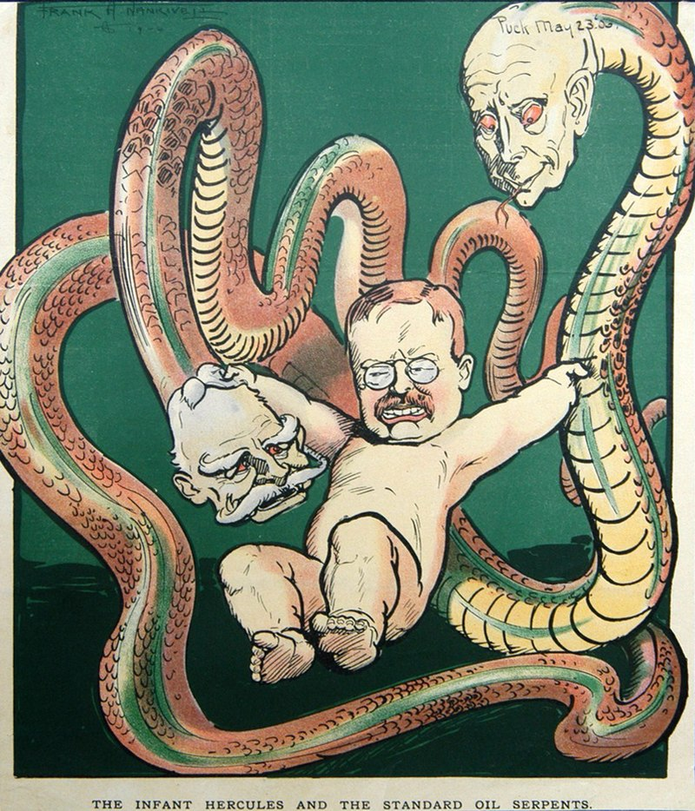
Company practices of driving competitors out of business led to the antitrust movement

Slide 7
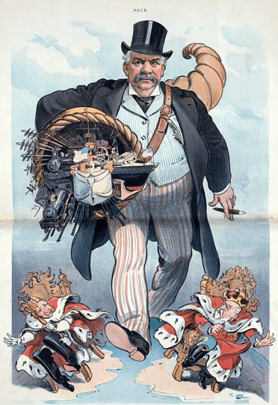
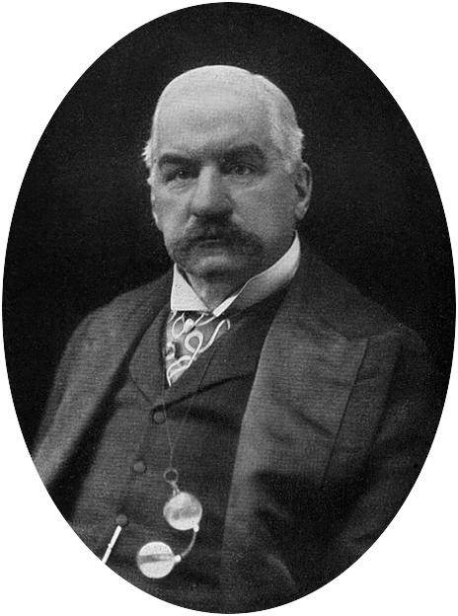
JP Morgan
Financier and investment banker
Morganization

Slide 8
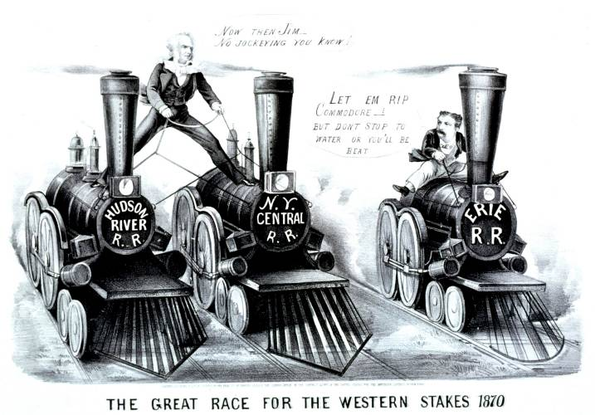
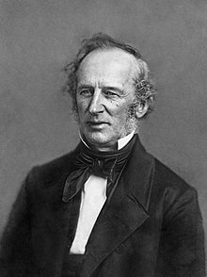
Cornelius Vanderbilt
Transformed transportation
Updated railroads and made them profitable through corporate management
Dominated shipping industry
Steamboats
Railroads

Slide 9
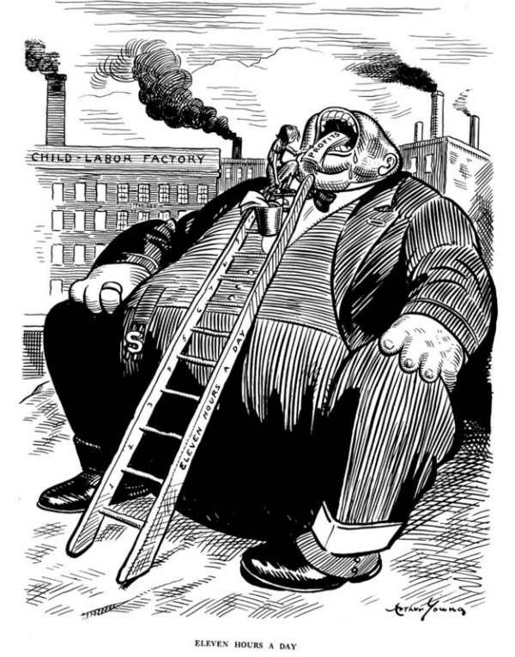
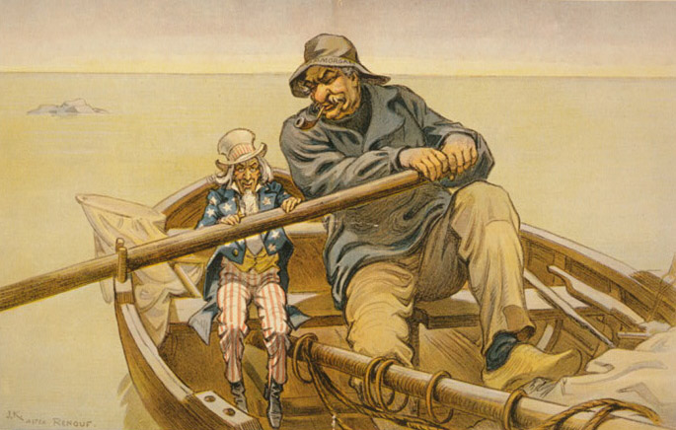
Dedicated to efficiency and modernization
Helped transform the American economy

Slide 10
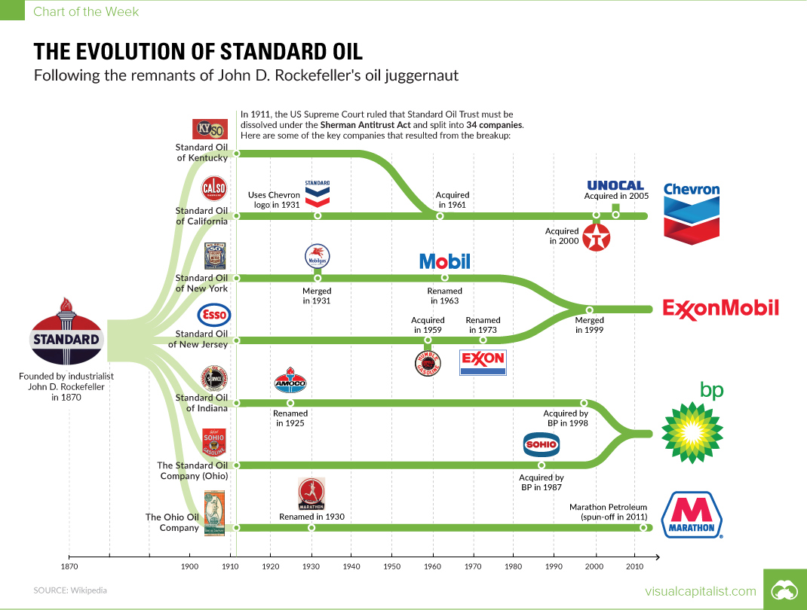
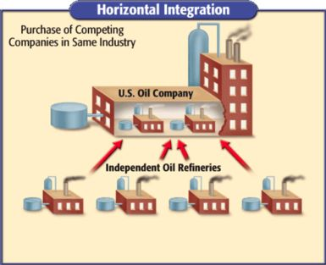
II. How’d they do it?
Horizontal Combination
Joining rivals that provide the same good or service
Limited competition

Slide 11
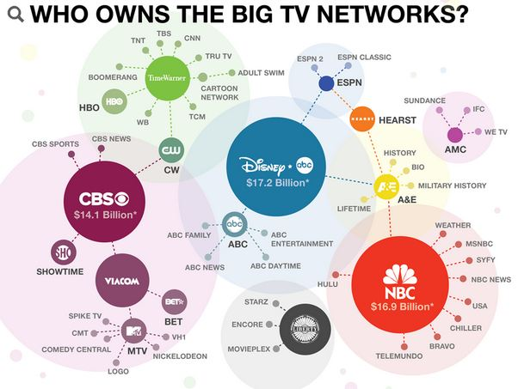
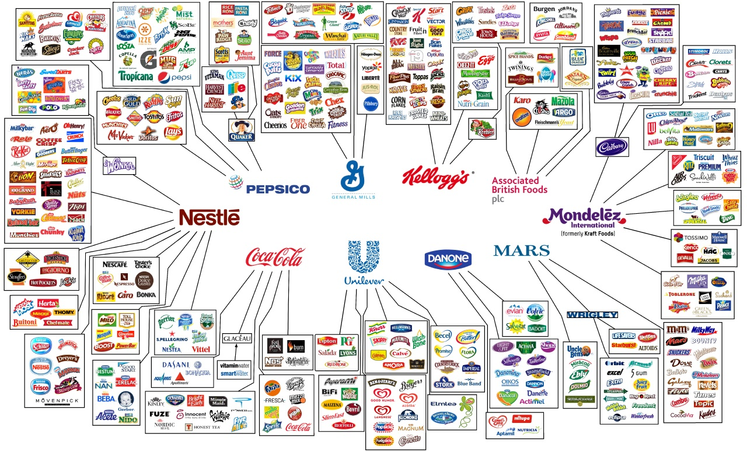
b. Vertical integration
Control over all factors of production:
Raw materials
Transportation
Factories
Marketing

Slide 12
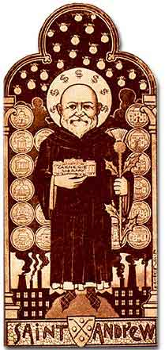
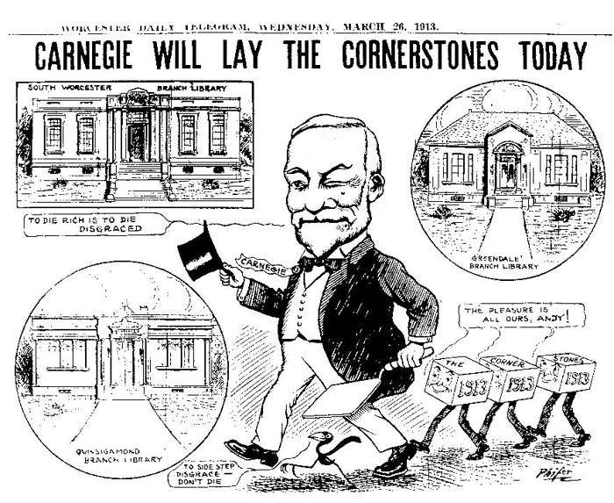
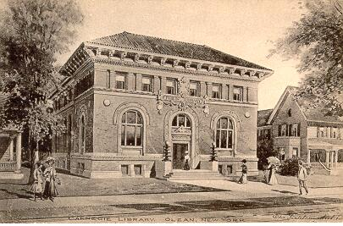
III. Justification
Gospel of Wealth
Urged rich to help the poor
Philanthropy

Slide 13
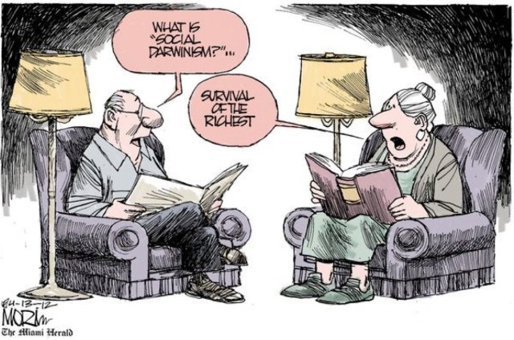
b. Social Darwinism
Social jungle doomed the “unfit” to poverty
Most fit were rewarded with wealth
Successful businesses were a product of natural selection

Slide 14
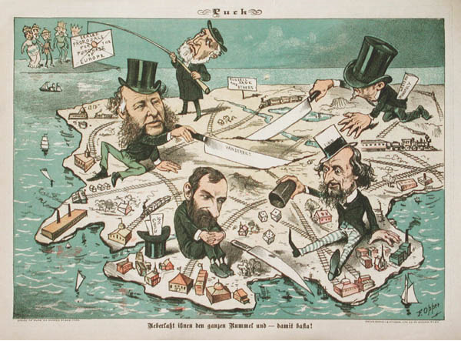
IV. Power to the People?
Wabash, St. Louis & Pacific R.R. v. Illinois (1886)
Only the federal government could regulate trade that crossed state boundaries

Slide 15
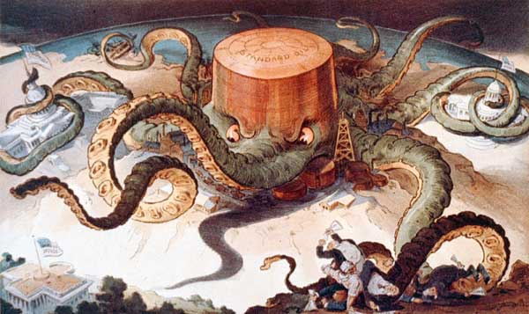
b. Sherman Antitrust Act (1890)
Forbid business from engaging in unfair business practices

Slide 16
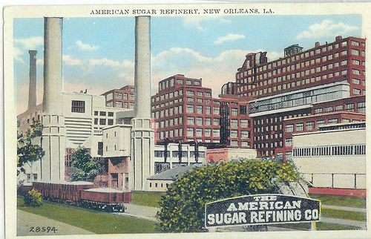
1. Only applied to interstate trade
Rarely enforced, until Theodore Roosevelt

Slide 17
b. Muckrakers
Exposed corrupt practices of cooperations

