Slide 1
Pregnancy, Birth, Parenting and Relationships
Chapter 9

Slide 3
?’s
Question #1
Question #2
Questions 3

Slide 4
Class Activity
In your notebook, write down some of your personal beliefs on what qualities a parent should have.
Ex. Adjectives to describe them, min/max age, educational level achieved, income….

Slide 5
Class Activity
In your notebook, write down some reasons to have/not have children now at your age, write down some reasons to have/not have children when you are older

Slide 6
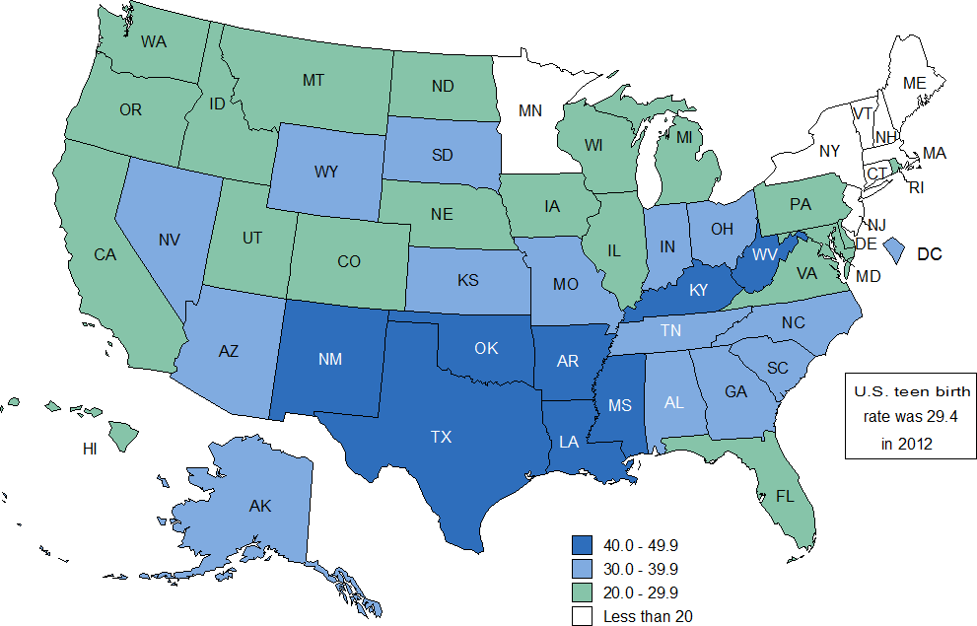
Stats
In 2013 there were 274,641 born to teenagers here in the US (Over 300,000 in 2012)
For every one of the above females, 1 in 6 gave birth to their second
Difference between abstinence and abstinence plus programs

Slide 7
Deciding To Have Children
Reasons for having the child:
What would a child want out of his/her parents?
Education
Love
Money
Adult
Good lifestyle habits

Slide 8
Planning a Family
What is a family?
What do they do?
Can the family provide food, clothing, shelter and medical care?
Who is going to take care of the child, who is going to work?

Slide 9
Teenage Pregnancy
A teen gives birth every minute of every day!
There are more than 3 million unintended pregnancies each year
Health problems…lifestyle habits
Feelings of overwhelmed and trapped
Drop out of school, public assistance
1 in 6 teenagers who engage in sexual intercourse become pregnant
“Can’t/won’t happen to me” (not just preg.)

Slide 10
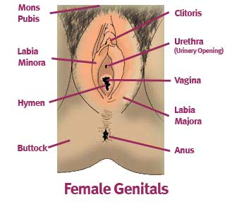

Slide 11
Conception and Pregnancy
One cell (egg/ovum) from a female and one cell from a male (sperm) meet, this union is called?
Fertilization

Slide 12
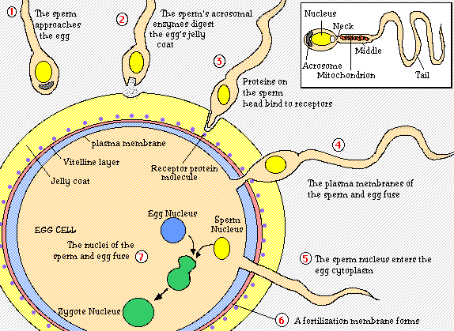

Slide 13
What’s Happening…
During an ejaculation as many as a half a billion sperm may be released
Three hundred make it to the fallopian tubes
All it takes is one sperm to fertilize an egg
Once one sperm enters the egg, the surface of the egg changes not allowing any other sperm in

Slide 14
Terminology
Zygote
Fertilized egg, traveling through the fallopian tubes
Blastocyst
A hollow sphere, once about 500 cells, implants on uterus wall
Implantation
The actual attaching to the uterus wall
Embryo
Once the blastocyst has been implanted it is now called an embryo

Slide 15
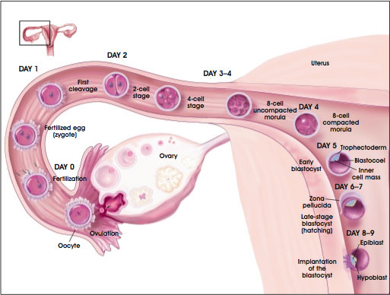

Slide 16
Symptoms Associated with Pregnancy
Missed or delayed menstrual cycle
HCG or human chorionic gonadotropin is produced by the embryo can be detected in the blood a few days after implantation
One week after menstruation cycle has begun HCG can be found in the urine
Distended abdomen
Minor vaginal bleeding
Lactating
Fatigue, sleeplessness
Nausea or vomiting
Lower back aches
Sensitivity in teeth
Headaches

Slide 17
Terminology
Placenta
Organ that holds the embryo to the wall of the uterus
Umbilical Cord
The cordlike structure that connects the embryo to the placenta
Amniotic Sac
The bag of thin tissue that encloses a developing embryo
Amniotic Fluid
The fluid in the amniotic sac, holds the embryo
Fetus
Name given to the developing embryo from the end of the second month of pregnancy until birth

Slide 18
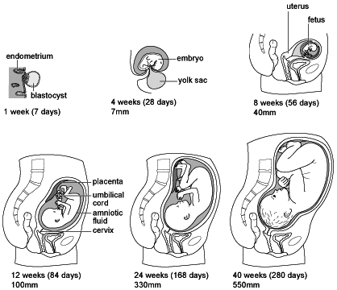
Mucus Plug
Vagina

Slide 19
Pregnancy divided into three periods known as?
Trimesters
First trimester
morning sickness, breasts enlarge/tenderness, urinate frequently, sleepiness, abdomen looks more rounded, carries the highest risk of miscarriage or the natural death of embryo or fetus
Second Trimester
fetus begins moving, constipation, indigestion, heartburn, breast milk being produced, the development of the fetus can start to be monitored and diagnosed
Third Trimester
gain 25-30 pounds, contractions, uterus preparing for birth, often marks the beginning of viability, the ability of the fetus to survive with or without medical help outside of the womb
***Sympathetic pregnancy is a condition where the father shares some of the physical discomfort the mother is feeling (Mental/Social leading to physical)

Slide 20
Development of the Fetus

Slide 21
Prenatal Care
Amniocentesis
Removal of a small amount of amniotic fluid from around the fetus to test to for more than 70 inherited disorders (14-16 weeks)
Chorionic Villus Sampling
A small piece of the chorion is removed for testing
Ultrasound
High frequency sound waves are used to create a picture of the developing fetus

Slide 22
Prenatal Care
Chances of having a healthy baby greatly increases if the mother practices good health habits and visits her doctor regularly throughout the pregnancy
FAS stands for…
Fetal Alcohol Syndrome – causes mental retardation due to damage received by the fetus's brain cells from alcohol

Slide 23
Effects on Pregnancy of Drinking and Smoking
Drinking alcohol during pregnancy can result in a serious side effect know as FAS or Fetal Alcohol Syndrome
It can be caused by less than 1 drink a day
No amount of alcohol is safe.
Smoking during pregnancy can also result in serious complications
Side effects include low birth weight, pre-term birth, and asthma
Nicotine found in cigarettes speeds up the infant’s heart
18%of Sudden Death Syndrome is a result of maternal tobacco use

Slide 24
Food and Nutrition During Pregnancy
Balancing carbs, fat, and proteins
Eating a variety of foods
Dairy products and several fruits and vegetables daily
Folic Acid is strongly needed at start of pregnancy to aid in the closing of the neural tube
Calcium, iron, fluoride, vitamin D and Omega 3 fatty acids are also needed

Slide 25
Stages of Birth
Labor
Last 4 – 24 hours, work of pushing the fetus out, uterus is contracting, cervix dilating, water breaks
Delivery
Lasts for a half hour to two, baby pushed through the cervix/vagina, usually head first, umbilical cord clamped/cut, mouth/nose suctioned, eye drops to baby, vitamin k injection
APGAR Score – 0-2 rating on the following: HR, breathing, muscle tone, reaction to stimulus, skin color

Slide 26
APGAR Score
Activity (muscle tone) 0 — Limp; no movement 1 — Some flexion of arms and legs 2 — Active motion Pulse (heart rate) 0 — No heart rate 1 — Fewer than 100 beats per minute 2 — At least 100 beats per minute Grimace (reflex response) 0 — No response to airways being suctioned 1 — Grimace during suctioning 2 — Grimace and pull away, cough, or sneeze during suctioning Appearance (color) 0 — The baby's whole body is completely bluish-gray or pale 1 — Good color in body with bluish hands or feet 2 — Good color all over Respiration (breathing) 0 — Not breathing 1 — Weak cry; may sound like whimpering, slow or irregular breathing 2 — Good, strong cry; normal rate and effort of breathing

Slide 27
Stages of Birth
Afterbirth
Delivery of the placenta, 15-30 minutes

Slide 28
Complications and Terms Associated with Pregnancy / Birth
Ectopic Pregnancy
Blastocyst becomes implanted in the fallopian tube, usually results in death of embryo
Miscarriage
The expulsion of a dead zygote, blastocyst, embryo or fetus
Stillbirth
Birth of a dead, full-term fetus
Toxemia
High blood pressure, protein in the urine and swelling due to fluid retention. Can lead to convulsions, coma and ultimately death

Slide 29
Complications and Terms Associated with Pregnancy / Birth
RH Factor
Mixture of positive and negative blood, causing mother’s blood to produce antibodies against the babies, blood trans.
Cesarean Section
Surgical method of birth
Premature Birth
Baby comes early in third trimester, lungs not developed
Incubators
Protective chamber designed to help baby until it is more developed
Twins
Multiple/Identical/Fraternal

Slide 30
Terms
Prenatal Care
Medical care during pregnancy
Contraception Planned Parenthood
Preventing pregnancy
Infertile
Unable to produce children
Adoption
Legal procedure of a child taken into a family to be raised as their own child
Foster Parents
Person/people that take care of children for periods of a time because biological parents may be unable to do so
Total public expenditures for births resulting from unintended pregnancies nationwide were estimated to be $12.5 billion in 2008. Of that, $7.3 billion were federal expenditures and $5.2 billion were state expenditures.

Slide 31
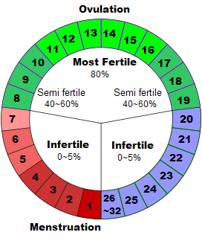
Make your Bracelets
Supplies per bracelet
5 Red beads
12 Yellow beads
(or any color you choose).
11 white beads
Stretch cord
1 safety pin
Notes:
31

Slide 32
Terms
Abortion
Having the embryo/child removed from the uterus, in NYS legal throughout the first trimester
Fun Fact
Does anyone know how much it cost to raise a child from birth to 18 years of age w/o paying for college?
To raise a child born in 2013 to the age of 18, it will cost a middle-income couple just over $245,000, according to newly released estimates from the U.S. Department of Agriculture.

Slide 33
Postpartum Period
Begins after deliver and lasts about 6 weeks
Mothers body goes back to normal
Prolactin is produced causing milk to form in the breasts
Oxytocin is causing the uterus to shrink
Hormones are dropping
Postpartum Depression

Slide 34
One day of having a child in HS:
Wake up to get M&C ready 6:15, leave 7:15
C DayCare or parents house 7:30 (DC $25/D)
M School 7:45 – 2:45
M+C 3:15 arrive home, snack play til 5:00
M/W/F work 5-9 ($8.75), 9-? Homework
T/Th. Cook dinner, clean 5-6:30
C eats at 6:30, bath 7, in bed 7:30
M 7:30 or 8-? Homework/relax/go to bed early
*Not on above schedule: illness, crying throughout the night, diaper changes, changing weather(time), changing costs, no sports/soc. life
M=Myself
C=Child

Slide 35
Reasons people get married?
Companionship
Security
Create a home/family
Escape from parents
Conform
Avoid Loneliness
Gain money or prestige
Get even w/ ex’s
Pregnancy

Slide 36
Love Vs. Infatuation
What is love?
Can/How you learn to love?
How is love portrayed in life? Songs, parents, families
Infatuation
Strong feelings

Slide 37
What makes a good marriage/ relationship?
Communication
Adaptability
Intimacy
Sexual Compatibility
Respect
Ability to give and take
Commitment

Slide 38
Current Trends in Marriage
Separation
Divorce
Split families
Custody – effect on children

Slide 39
Associated Terms
Masturbation
Oral Sex
Intercourse V. Outer-course
Homosexual v. heterosexual v. bisexual
Transvestite v. transsexual/transgender

Slide 40
Gender Roles
Males V. Females
Class activity divide class into males v. females
Come up with ideal male/female of a ‘male’ ‘female’
How they should carry themselves
Act, talk, walk, sit….

Slide 41
Final Words
Thankfully these trend are starting to subside due to adolescents who are waiting to have sexual intercourse and the increased use of contraceptives by teens. (teenage pregnancy)
Be open and honest/trustworthy with people
Under 17 years of age: New York law states that a person less than 17 years of age is legally incapable of consenting to sexual intercourse or other sexual contact.
Good communication with boyfriend/girlfriend (Intentions/STD)
Change of mind/maturing
Make wise/educated decisions
Follow your dreams and goals
Do NOT allow one bad decision to dictate the rest of your life!!!!!

Slide 42
Works Cited
http://www.hhs.gov/ash/oah/adolescent-health-topics/reproductive-health/teen-pregnancy/trends.html
http://www.cdc.gov/reproductivehealth/data_stats/
http://www.guttmacher.org/pubs/FB-Unintended-Pregnancy-US.html

