Slide 1
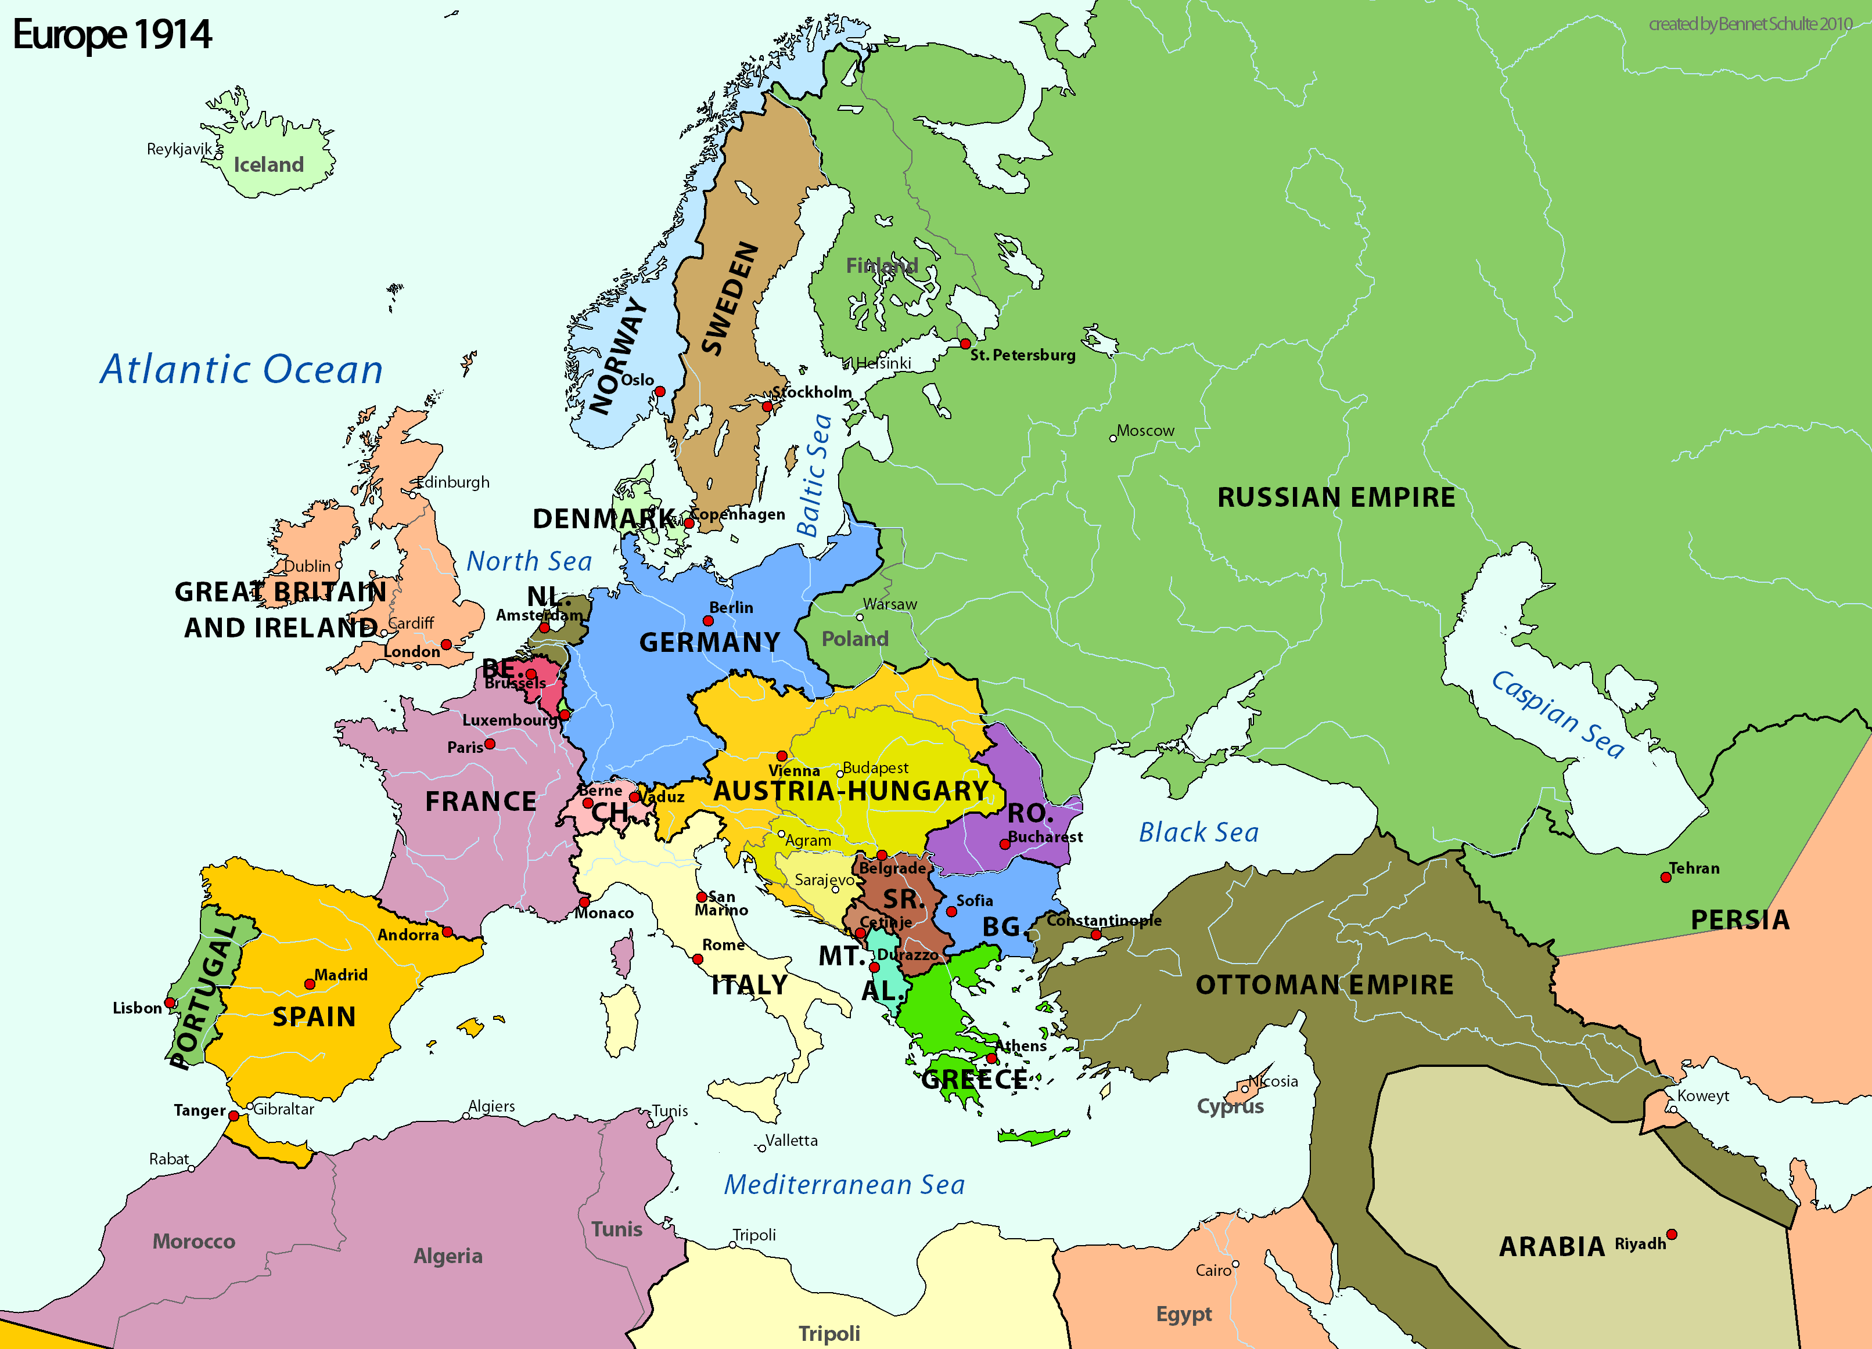
What happened to Ottoman Empire
After WWI?
This Photo by Unknown Author is licensed under CC BY-SA

Slide 2
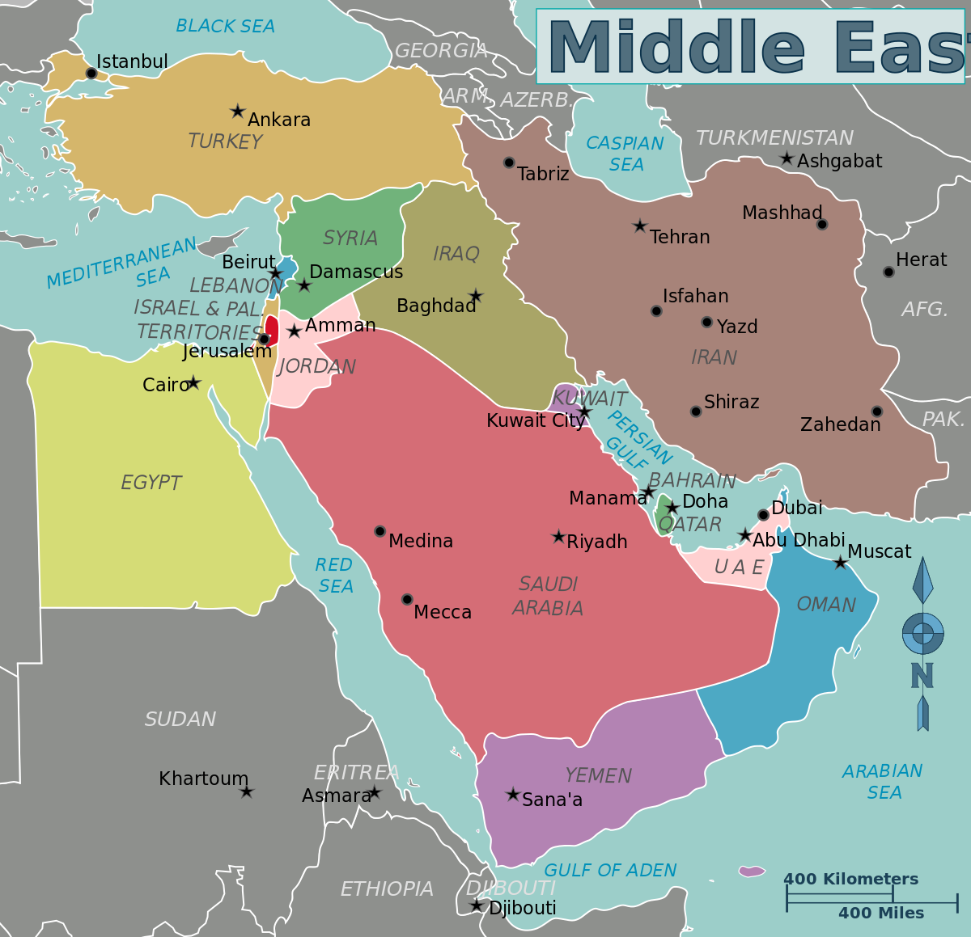
Ottoman Empire
After WWI, due to the Treaty of Versailles, the Ottoman Empire was forced to give up most of its land to the Allies
One new country to emerge out of the old Ottoman Empire was a large section renamed Turkey
This Photo by Unknown Author is licensed under CC BY-SA

Slide 3
Turkey
Turkey was a highly sought after piece of land
Filled with rich fertile soil and OIL!!
Many foreign nations tried to take the land!
This Photo by Unknown Author is licensed under CC BY-SA

Slide 4
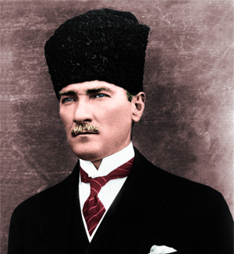
Mustafa Kemal
A young General named Mustafa Kemal led Turkish armies to many victories against foreign invaders
Kemal eventually left the military to focus on running a political campaign
This Photo by Unknown Author is licensed under CC BY-SA

Slide 5
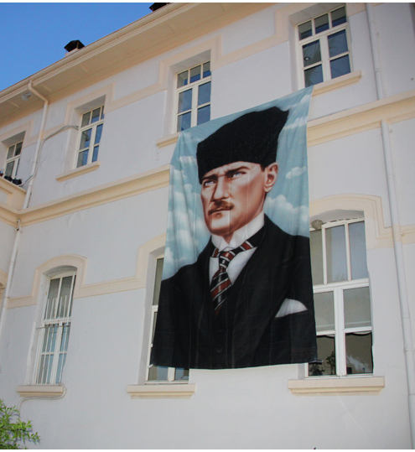
Political Career
Kemal was responsible for creating the Turkish Grand National Assembly (DEMOCRACY)
Kemal did not support Communism as his fellow neighbors
Kemal was given the nickname “Ataturk” which meant “FATHER OF THE TURKS”
This Photo by Unknown Author is licensed under CC BY-SA

Slide 6
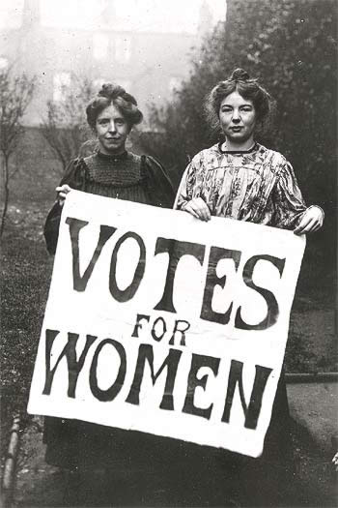
Ataturk’s MODERNIZATION
1. Established Freedom of Religion throughout Turkey
2. Created a new legal system based on Western law
3. Granted women the right to vote and hold public office
4. Launched a government funded program to industrialize Turkey and spur economic growth
This Photo by Unknown Author is licensed under CC BY-SA

Slide 7
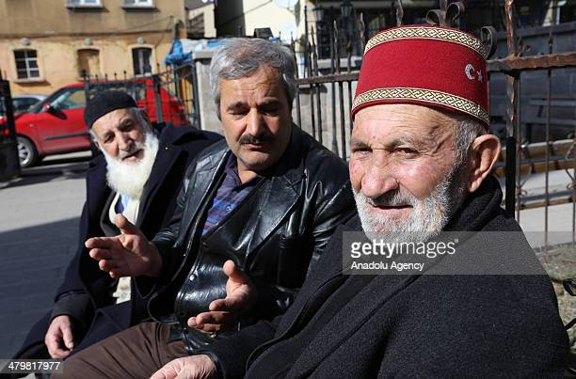
The Fez becomes “optional headwear”
Traditional head coverings in the Ottoman Empire were called a Fez
The Fez symbolized devotion to one’s religion (Islam, Christian, Jews) but also devotion and support of the Sultan (Monarch)
Making the Fez optional would have been a progressive movement towards MORE HUMAN RIGHTS AND CHOICES!

Slide 8
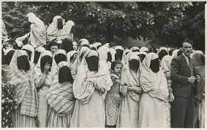
Mustafa Kemal Makes The Veil Optional

Slide 9
LIFE WITHOUT A VEIL
WHY WOULD SOME WOMEN RESIST REMOVING THE VEIL?
WHY WOULD SOME WOMEN LOVE REMOVING THE VEIL?
1.
2.
3.
4.
1.
2.
3.
4.

Slide 10
Mustafa Kemal Introduces Western Alphabet

Slide 11
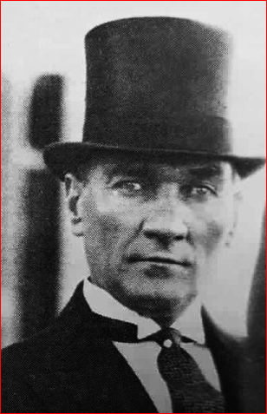
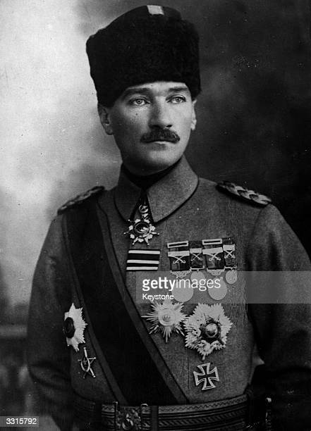
What do I need to know for Regents?
1. Modernized and Westernized Turkey
2. Encouraged citizens to ABANDON OLD AND TRADITIONAL WAYS!
3. Most Turks accepted and liked his new ways
Ataturk did not permit people to disagree with him
Ataturk only allowed one political party
He died in 1938, and is viewed as a national hero
This Photo by Unknown Author is licensed under CC BY-NC

Slide 12
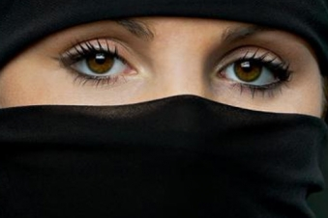
Turkey Today; The Veil Debate
1. After Kemal’s death, the Turkish government turned extreme and declared that religion and Education/Politics could and should not be mixed; veils were forbidden
The veil was considered ILLEGAL in public education and political buildings such as schools, libraries, universities and political buildings
Women were arrested for TRYING TO WEAR the veil….
The current Turkish President dropped the veil ban and allowed women to choose whether to wear one or not…

