Slide 1
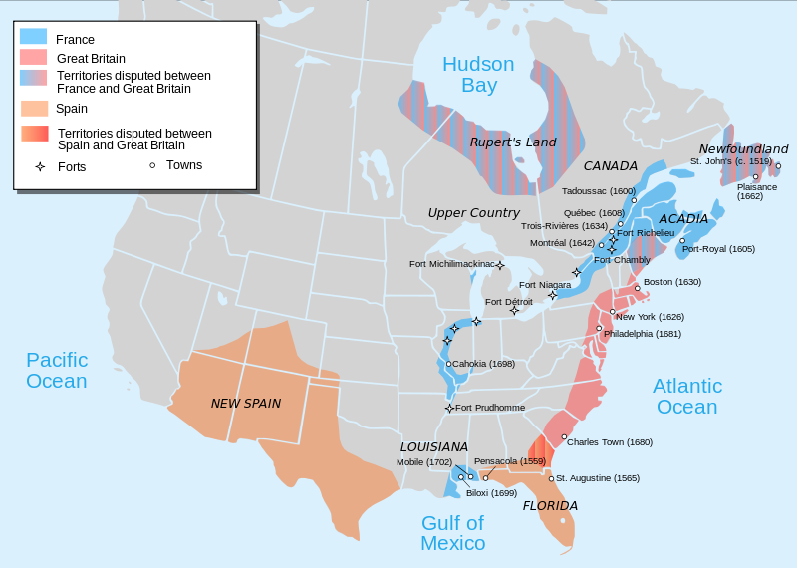
Colonization

Slide 2
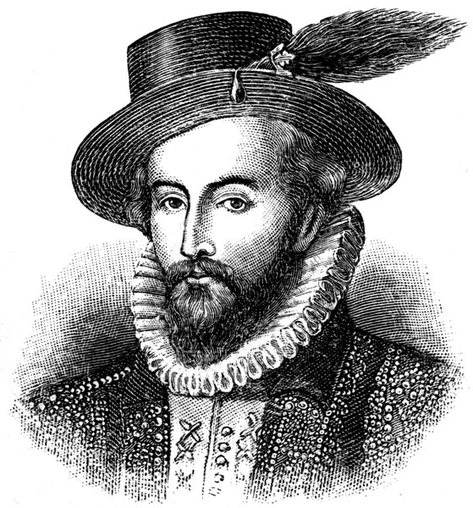
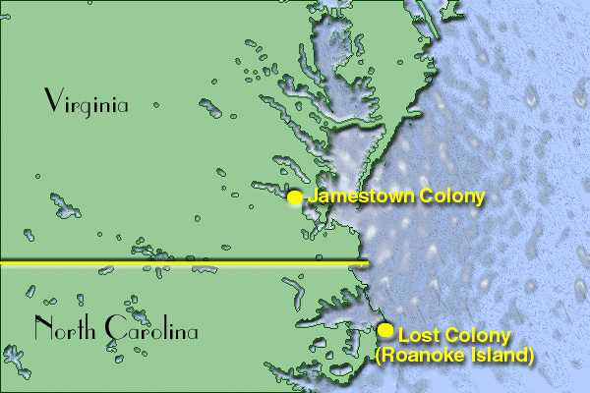
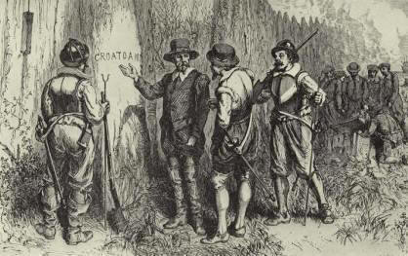
I. England Enters the Americas
Sir Walter Raleigh
Roanoke
Failed colony

Slide 3
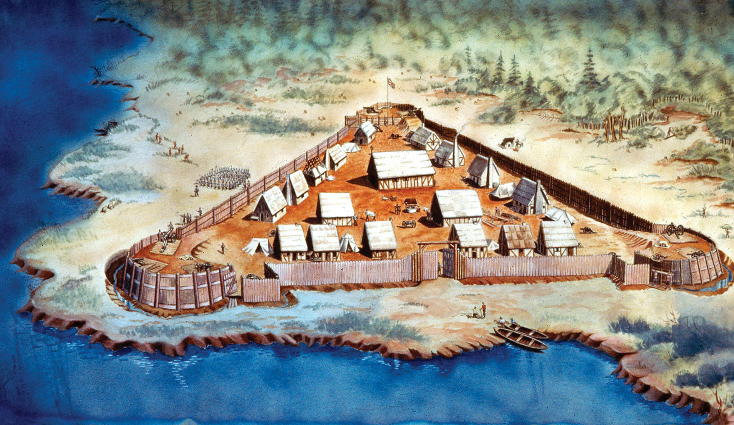
- Jamestown - 1609
First permanent English settlement in the Americas

Slide 4
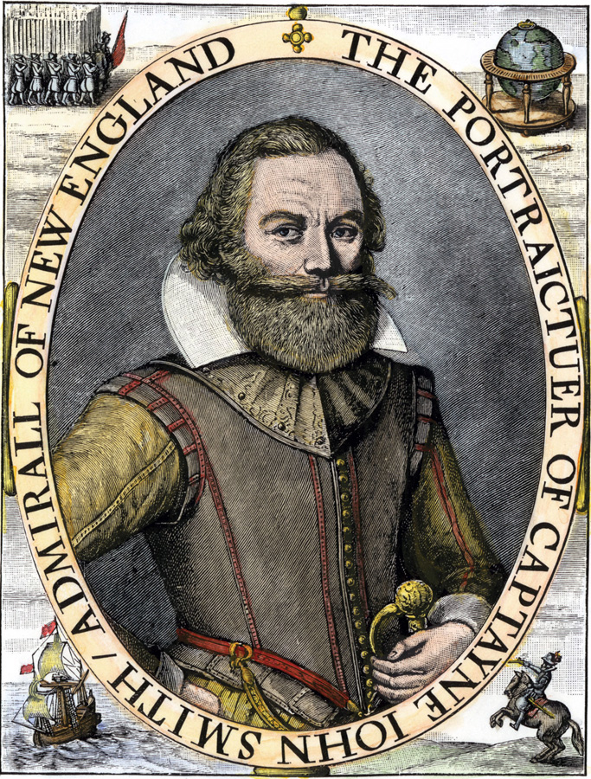
Failed to farm right away
Bullied natives for food
John Smith
“He that will not work shall not eat!”

Slide 5
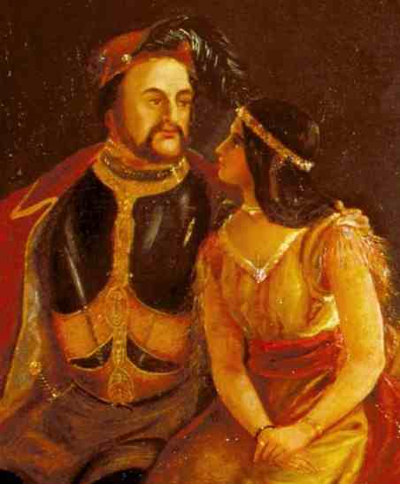
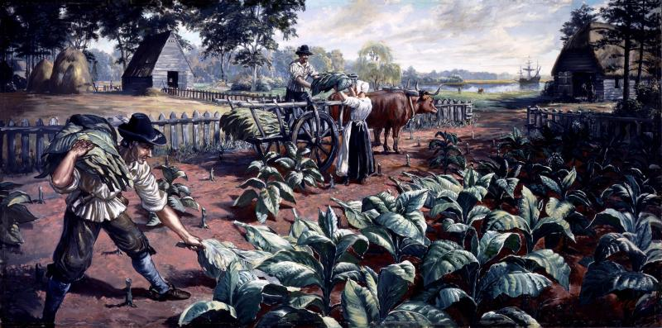
- John Rolfe
Introduced tobacco farming

Slide 6
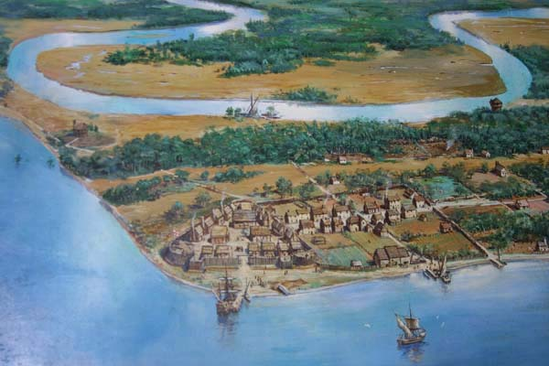
Tobacco crop allowed Jamestown to survive
Created conflict with natives pushed off their land

Slide 7
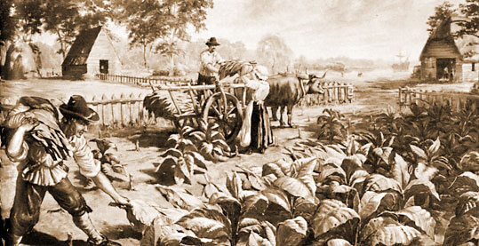
- Joint stock company
Planned to send poor/unemployed to Virginia
Indentured Servants/Headright System
Passage paid in return for 7 years of labor
Owner received 50 acres of land
Profits would be returned to the stock holders

Slide 8
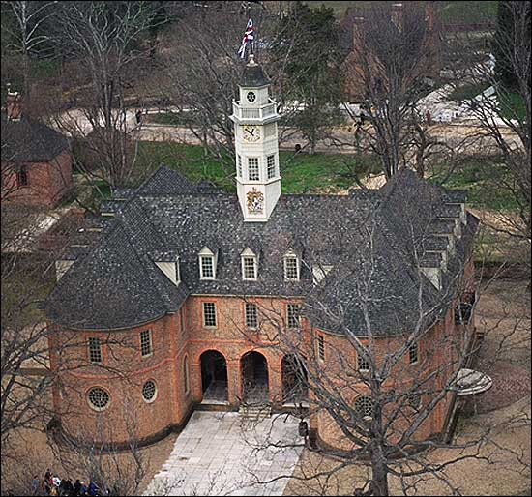
- Representative Assembly
House of Burgesses
Began representative government in the colonies

Slide 9
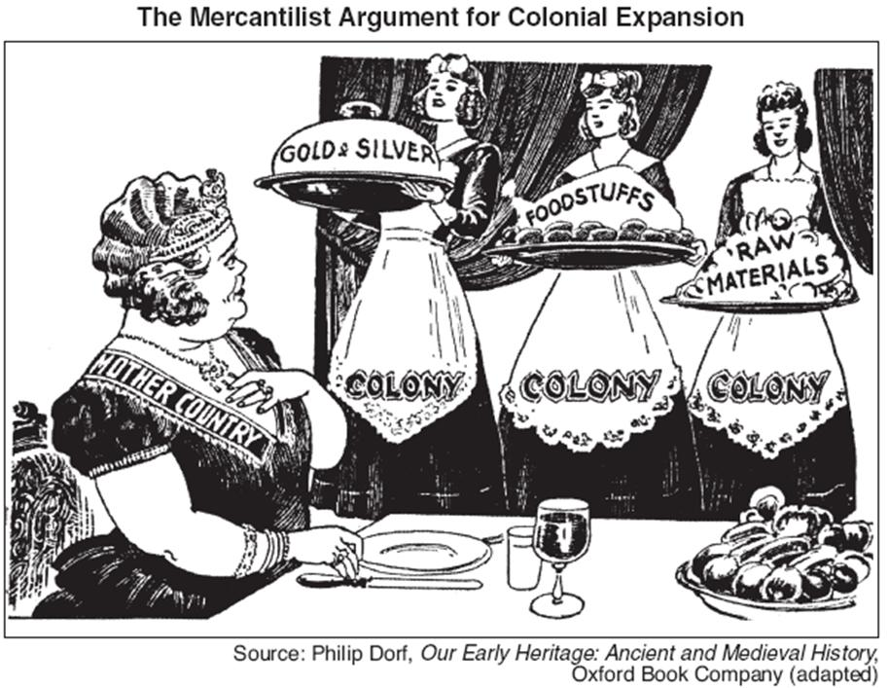
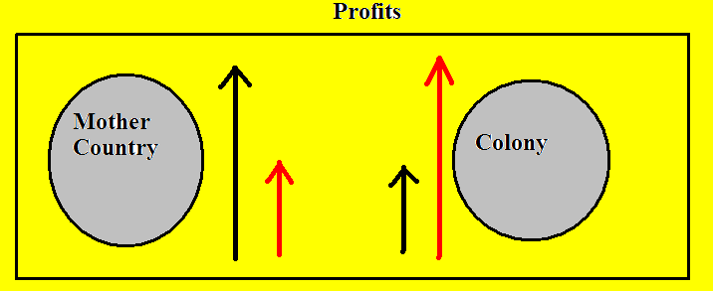
II. Mercantilism
- Nations plan to regulate and protect industry
Enrich the nation through a favorable balance of trade

Slide 10
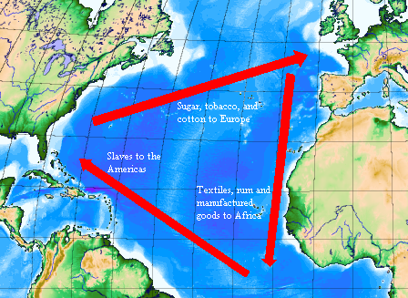
Colonies would supply raw materials
Mother country would provide finished goods

Slide 11
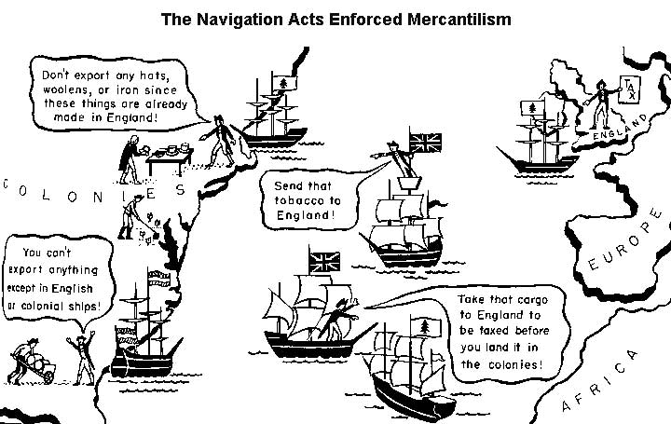
- Navigation Acts
Ordered colonies to only export goods to England
Created a monopoly on cash crop goods
Rarely enforced
Salutary Neglect

Slide 12
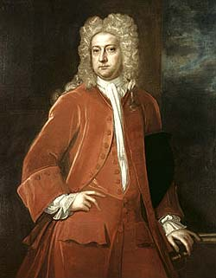
III. Bacon’s Rebellion
Colonial disagreement over how best to protect against native attacks
Governor William Berkeley
Wanted to build forts

Slide 13
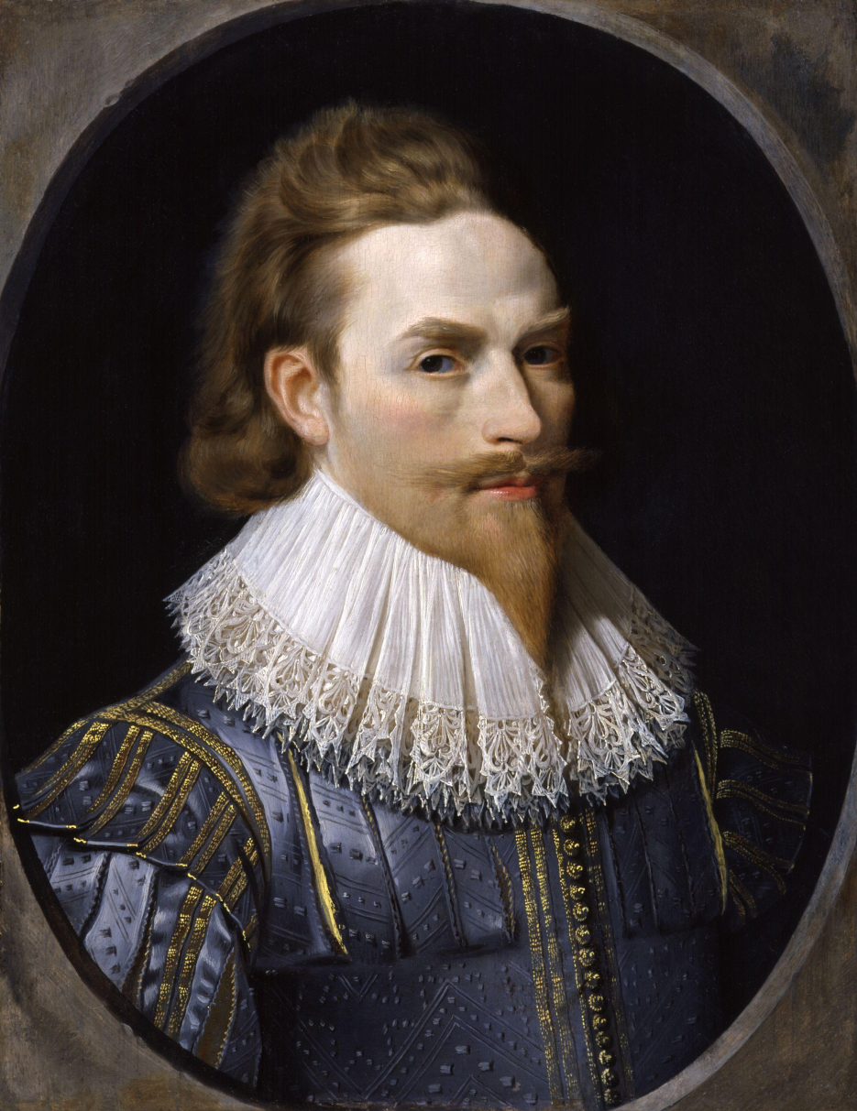
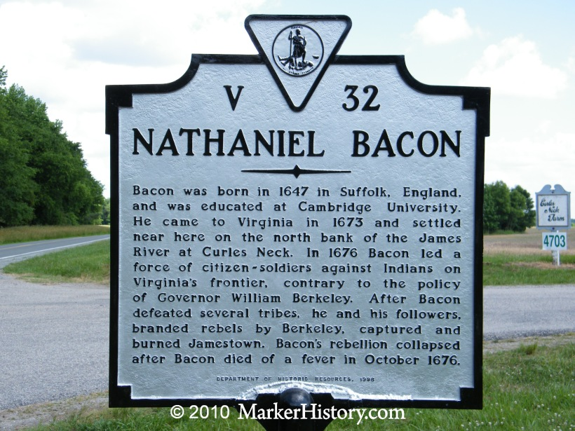
- Nathaniel Bacon and Rural farmers
Did not believe this forts would protect their land
Attacked Natives

Slide 14
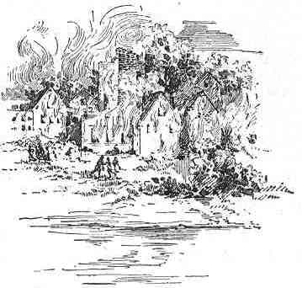
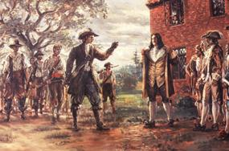
- Berkley and Bacon’s force fought
Bacon burned Jamestown
Followers were executed without due process
What rights did you have as Englishmen in the colonies?

Slide 15
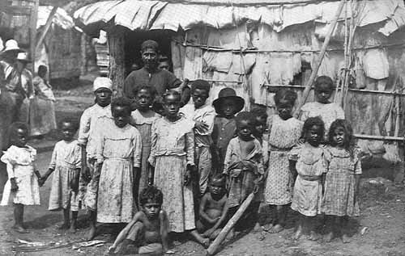
IV. Move toward African Slaves
- Death rate among servants decreased
Made owning slaves more cost effective than having servants
Owned children as well

Slide 16
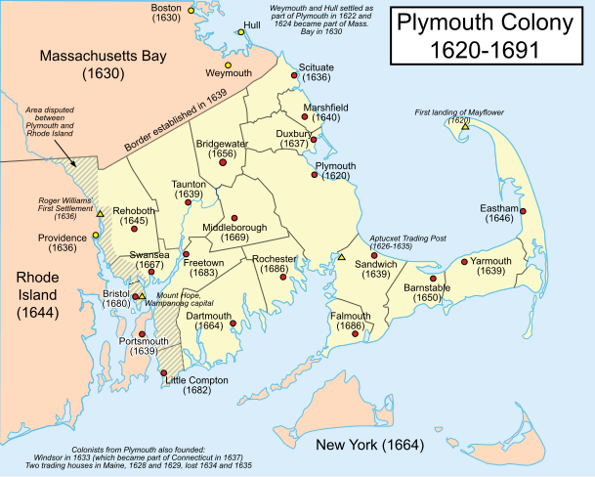
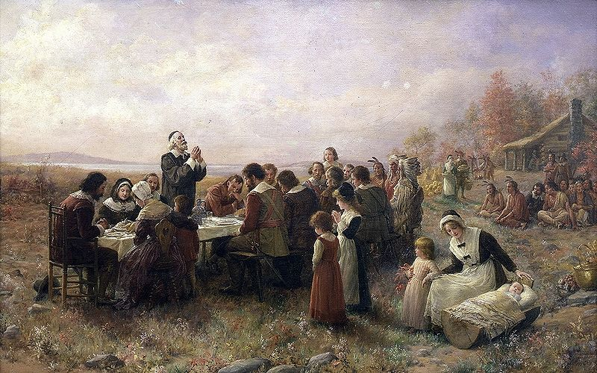
V. Plymouth
- New England’s first permanent English settlement
Pilgrims/Puritans
Sought religious freedom

Slide 17
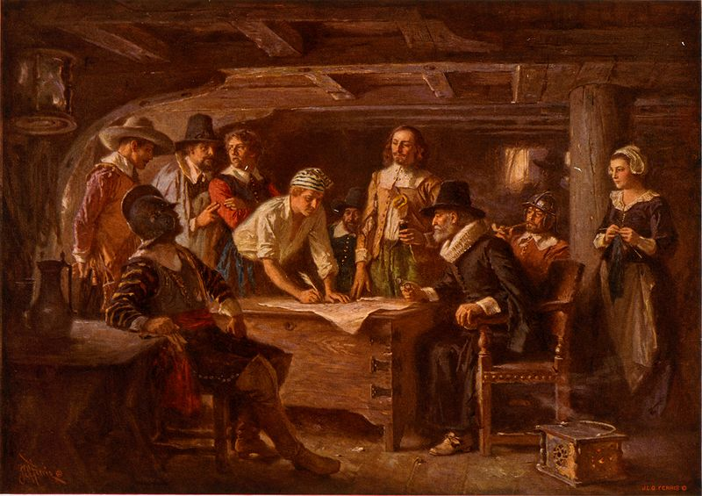
- Mayflower Compact
Start of American democracy
Set up representative government
created “just and equal laws . . . for the general good of the colony.”

Slide 18
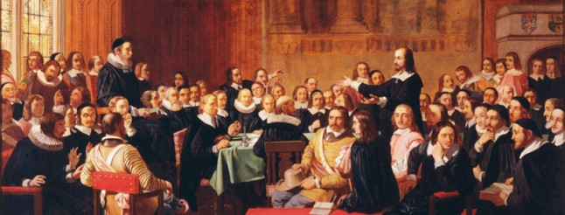
Town hall meetings
All adult males of the church could vote

Slide 19
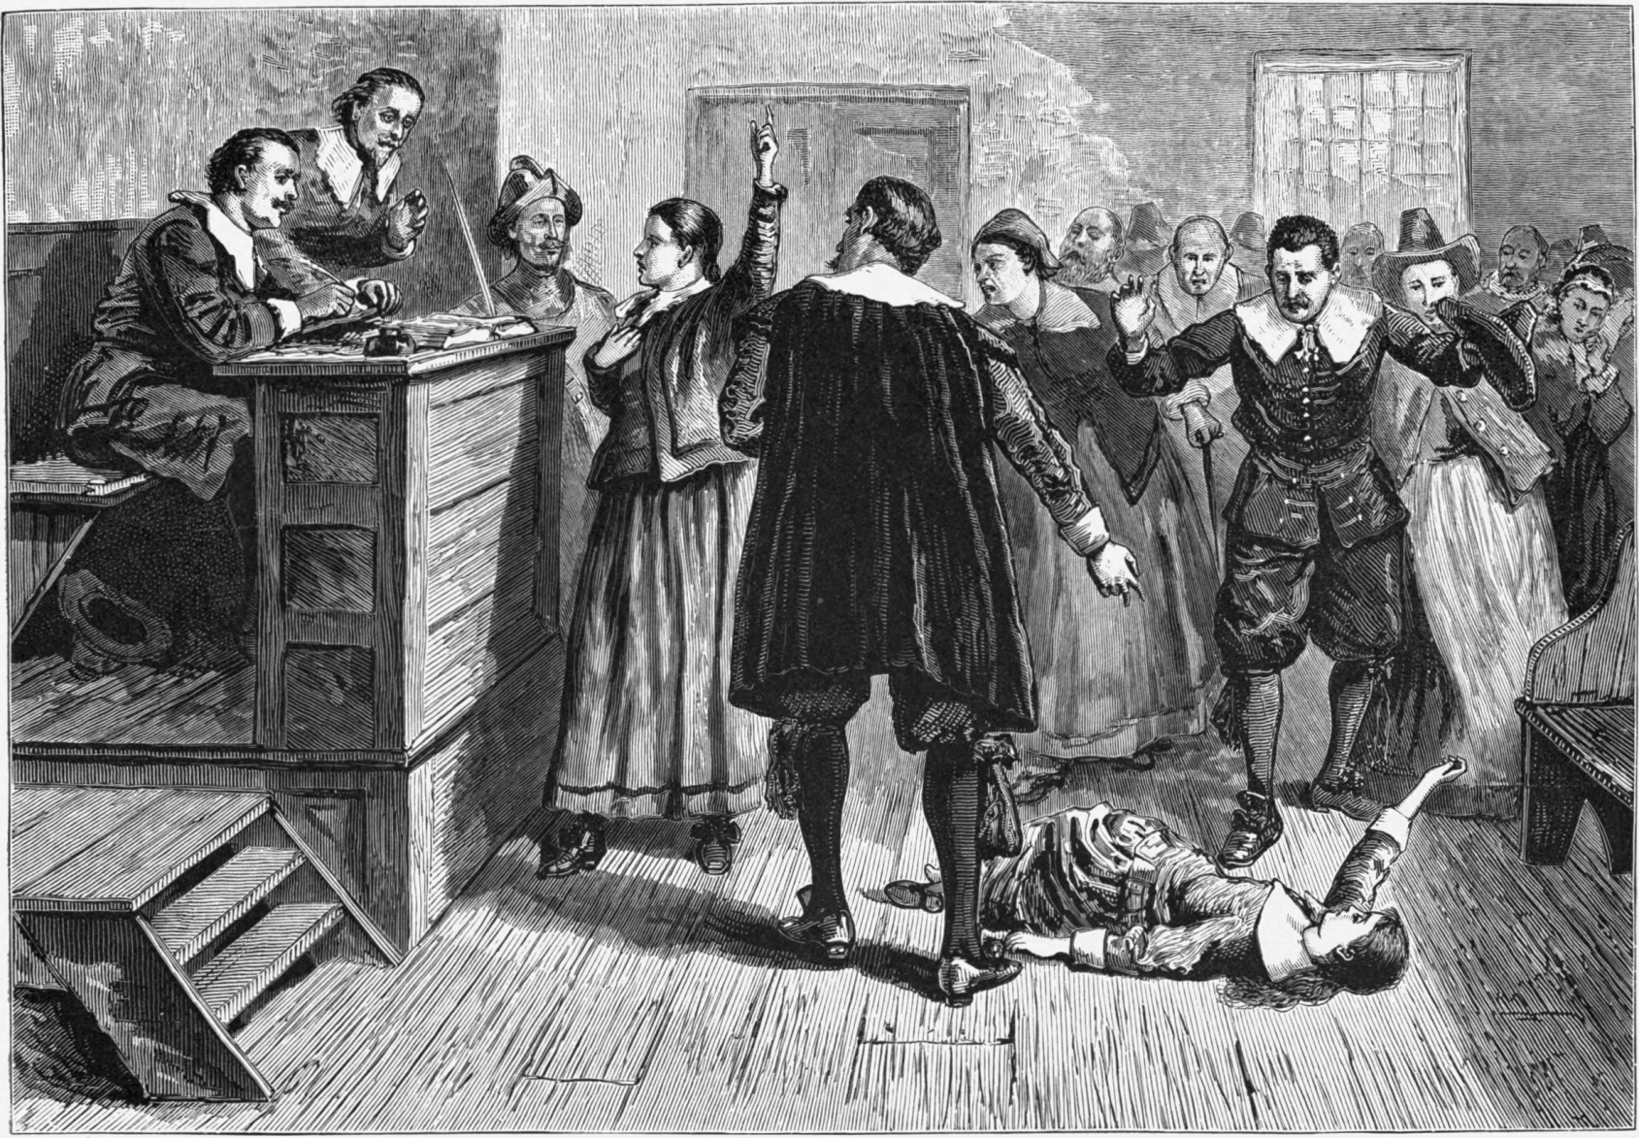
- Salem Witchcraft
Mass hysteria
Aimed at independent women

Slide 20
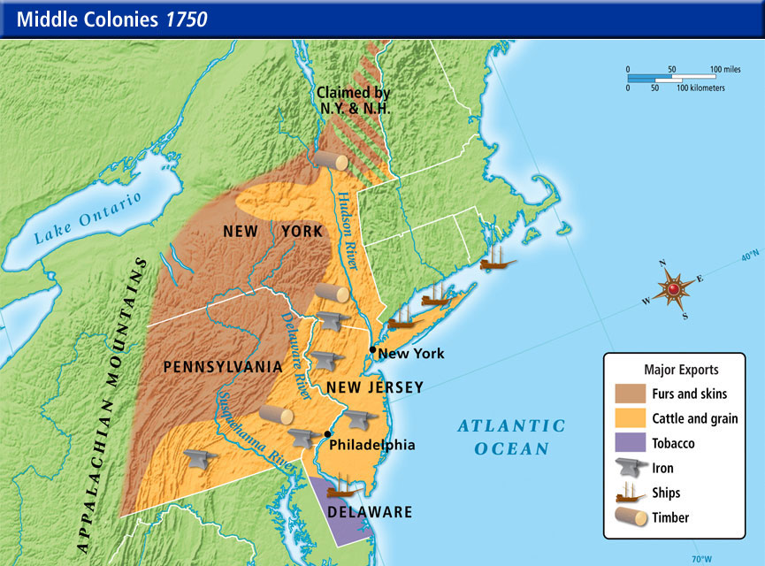
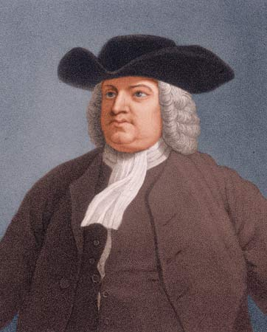
VI. Middle Colonies
Breadbasket colonies
Proprietor Charters
Trade
Religious freedom

