Slide 1
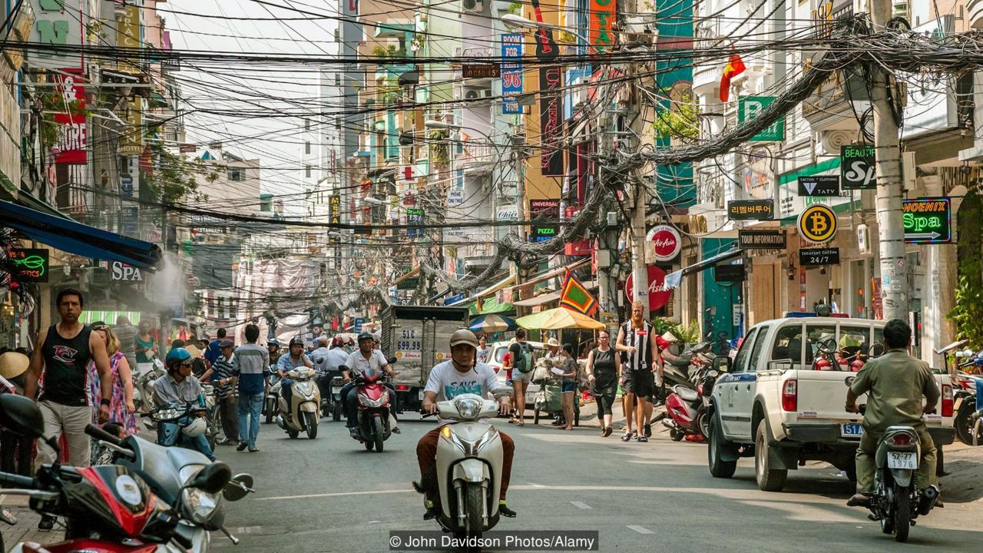
Ho Chi Minh City Vietnam
Ho Chi Minh City/Saigon-Vietnam

Slide 2
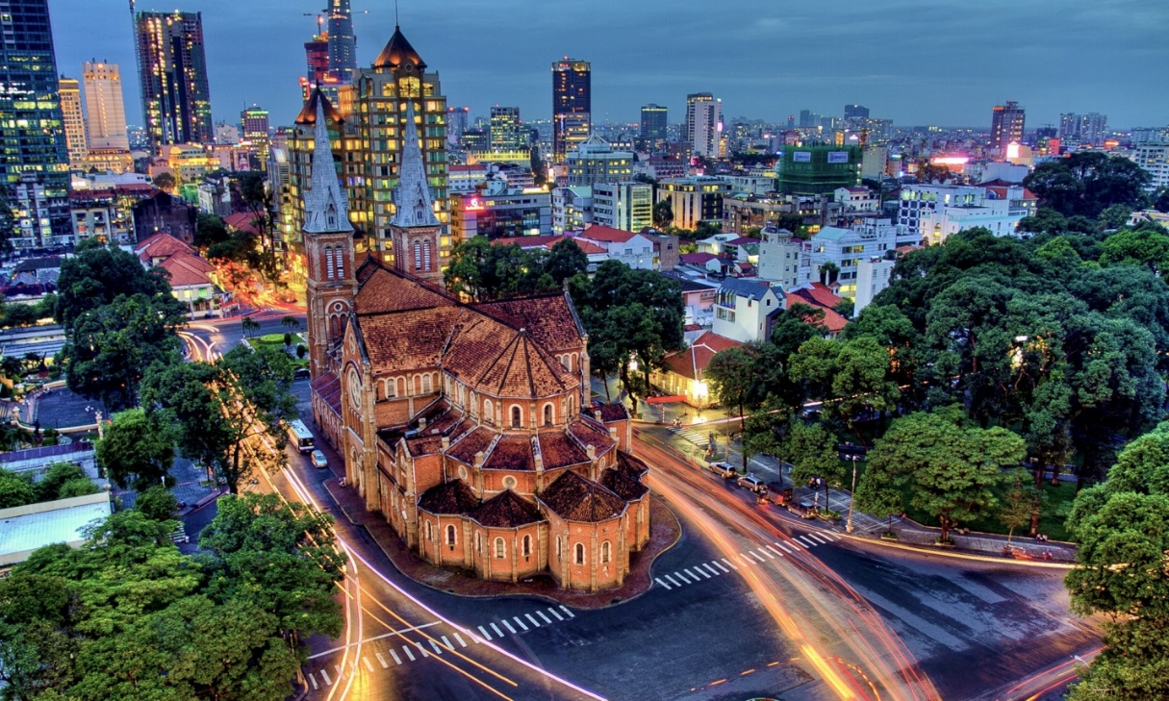
Ho Chi Minh City Vietnam
Ho Chi Minh City/Saigon-Vietnam

Slide 3
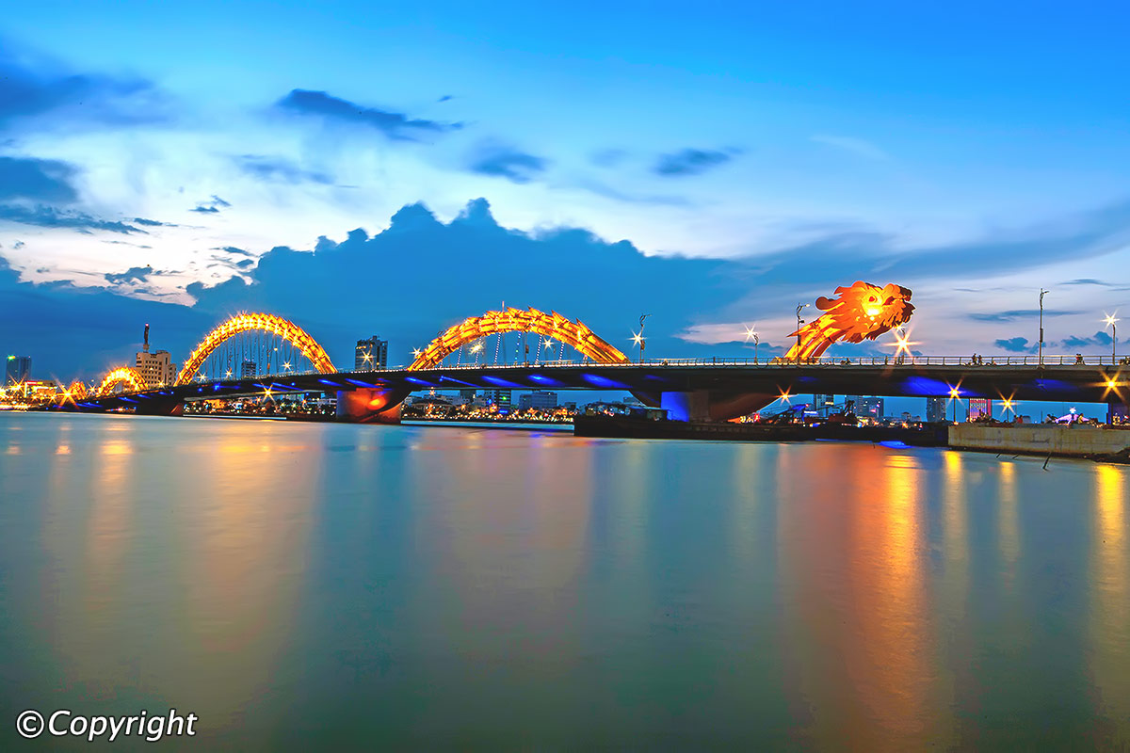
Da Nang-Hoi An
Ho Chi Minh City/Saigon-Vietnam

Slide 4
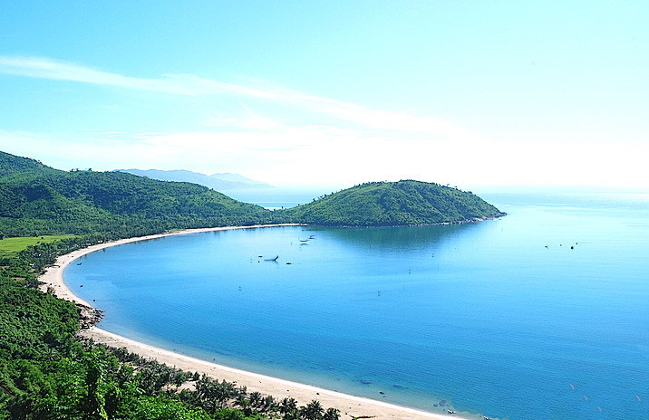
Da Nang-Hoi An

Slide 5
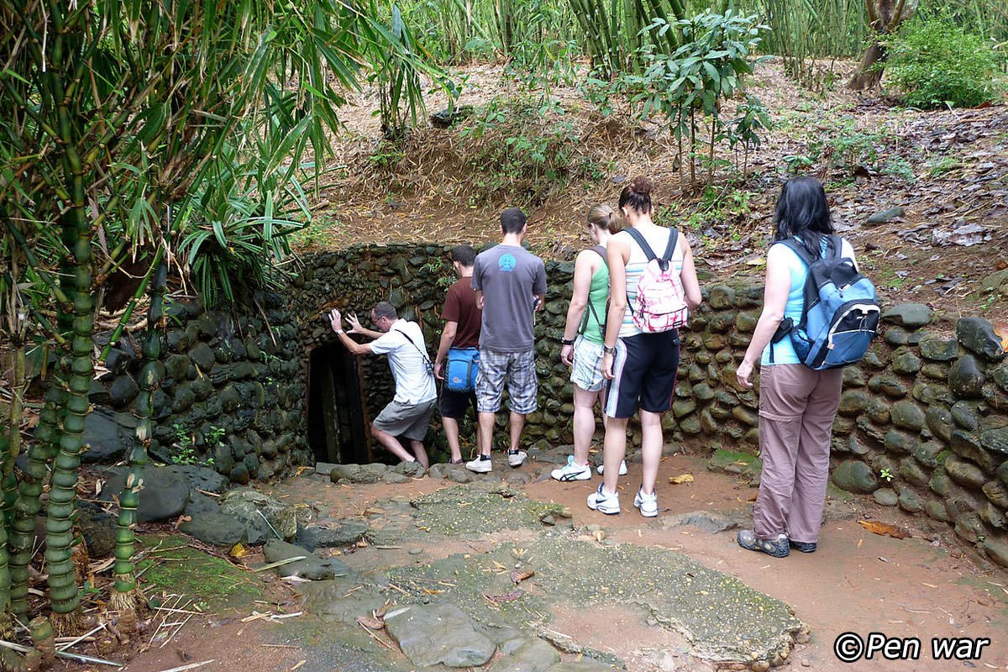
Chu Chi Tunnels-Vietnam

Slide 6
Chu Chi Tunnels-Vietnam

Slide 7
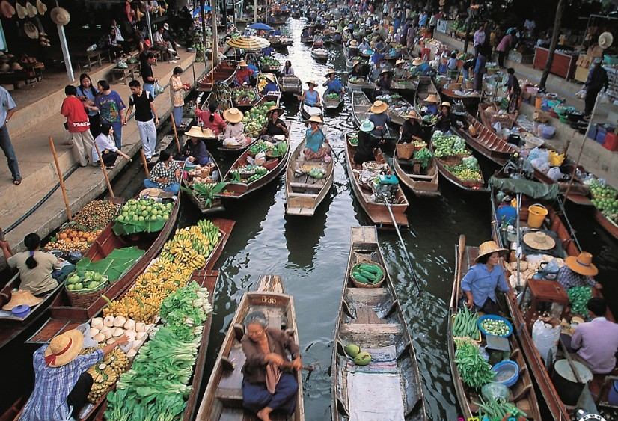
Floating Markets

Slide 8
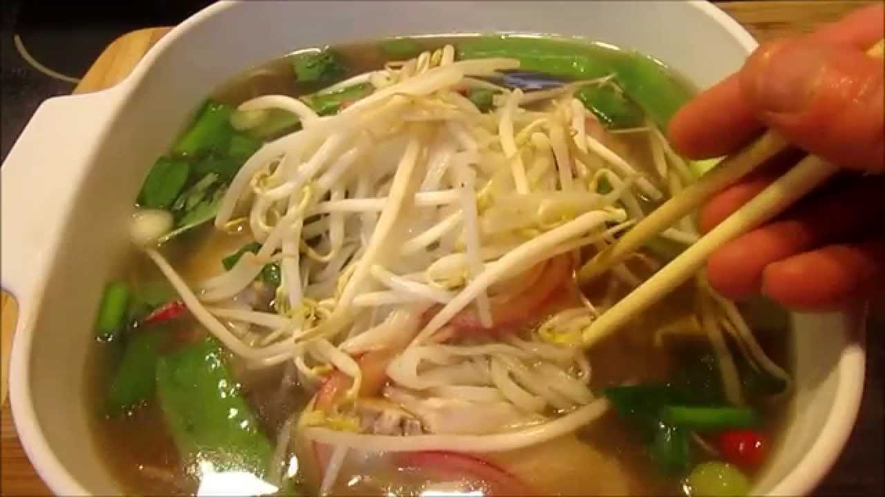
Pho noodle soup--

Slide 9
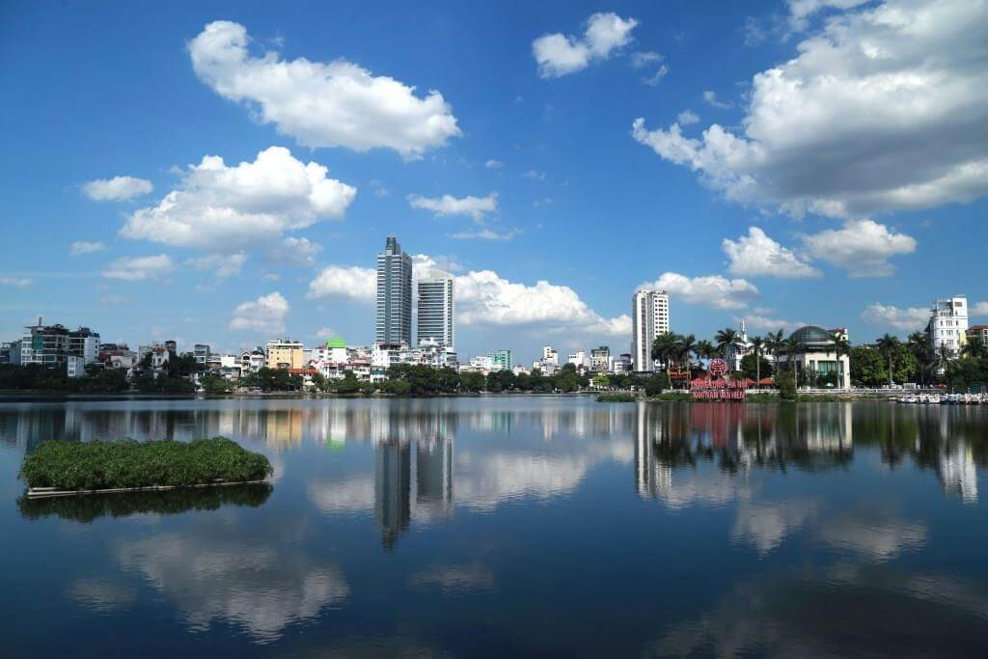
Truc Bach Lake--Hanoi

Slide 10
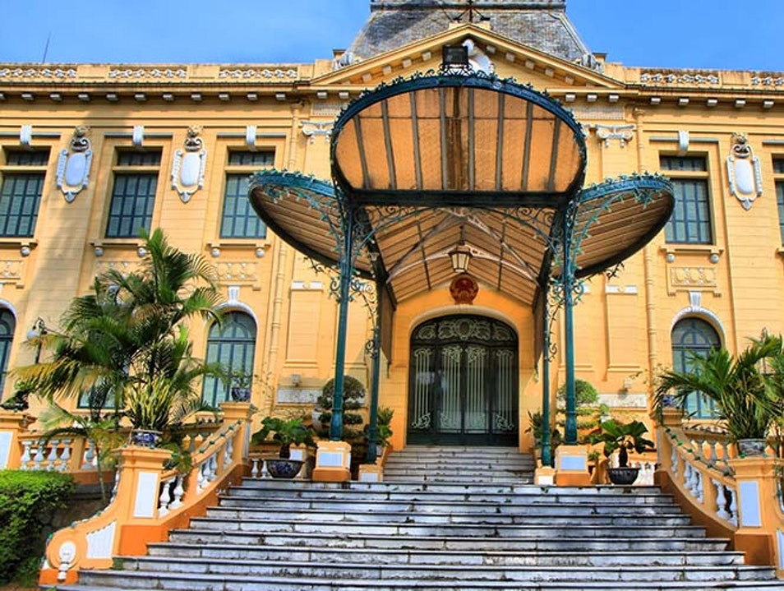
French Quarter

Slide 11
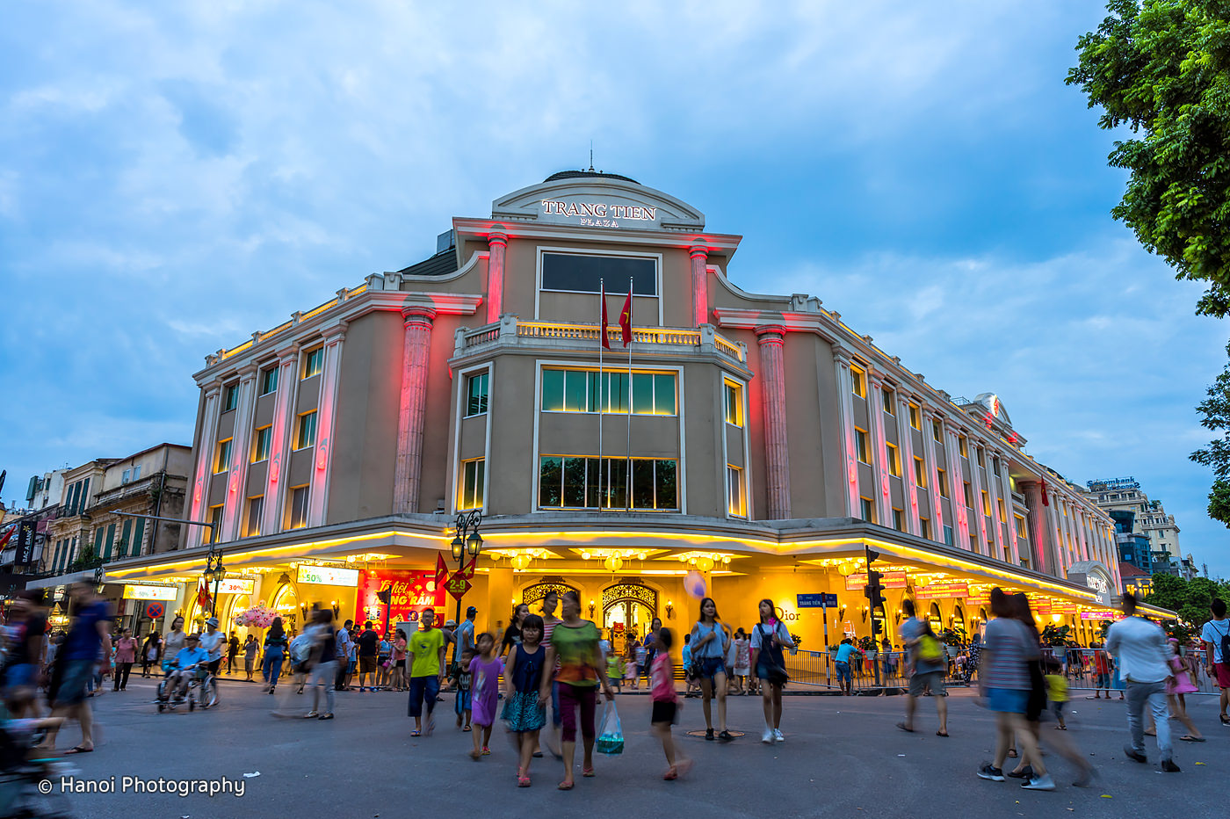
French Quarter

Slide 12
Ha Long

Slide 13
Ha Long

Slide 14
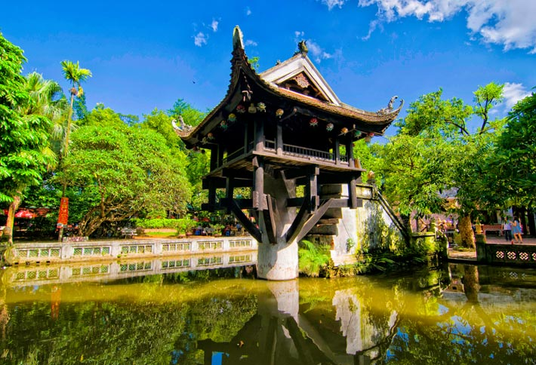
One Pillar Pagoda

Slide 15
Ham Luong River

Slide 16
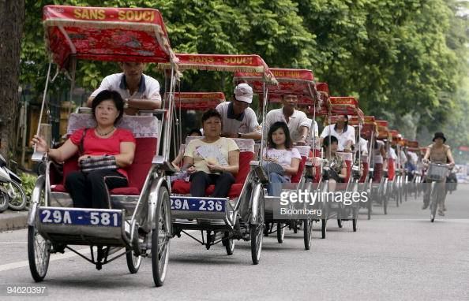
Rickshaw tour

Slide 17
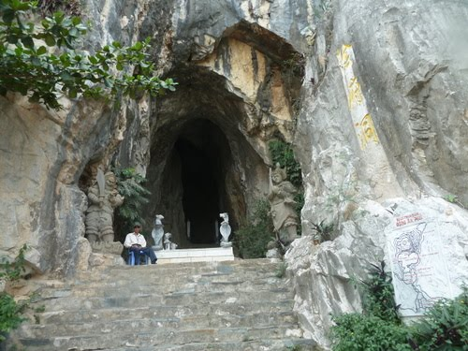
Am Phu Caves

Slide 18
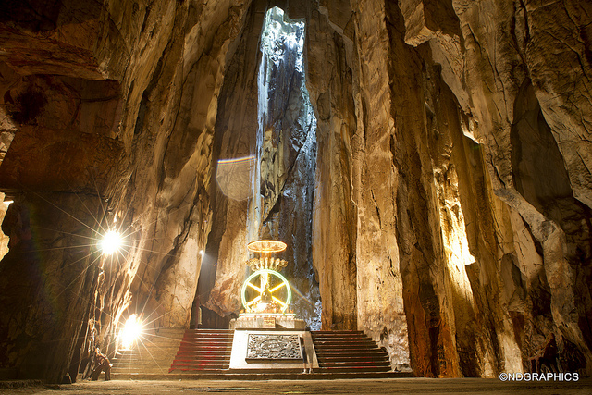
Am Phu Caves

Slide 19
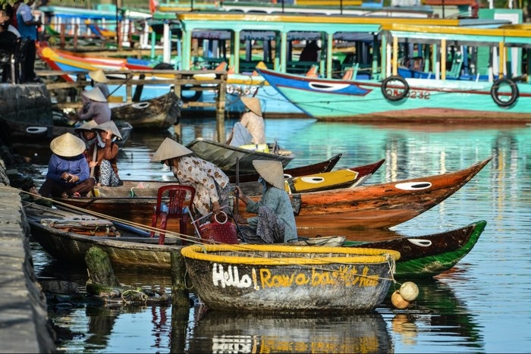
Da Nang Bamboo basket boat

Slide 20
Da Nang Bamboo basket boat

Slide 21
Am Phu Caves

Slide 22
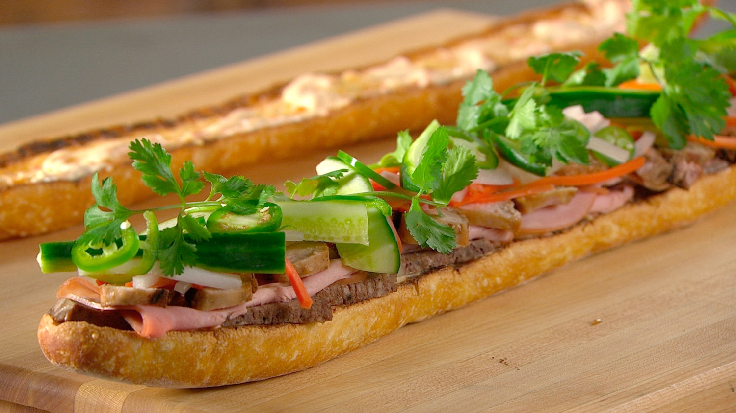
Banh Mi Sandwich

Slide 23
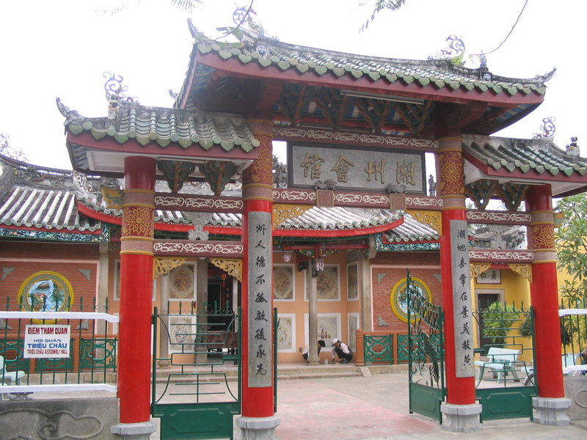

Slide 24
$3,455 until Oct. 31

Slide 25
